Slide 1


Pharmacodynamic assessment for the PK/PD approach in antimicrobial therapy
Aude Ferran
May 2022

Slide 2
Indicators of the effect of antibiotics on bacteria
In vitro
  MIC, MBC
  Rate of bacterial killing
  Extent of the reduction of the inoculum
In vivo
  Clinical outcomes: bacteremia, hyperthermia, leukocytosis, survival/death,...

Slide 3
PD assessment
by MIC and MBC determination

Slide 4
MIC
  Definition
  MIC and inhibition diameter
  MIC for antibiotic combinations
MBC
Classification of bacteriostatic vs bactericidal drug

Slide 5
MIC and MBC
MIC = Minimum Inhibitory Concentration: smallest concentration of antibiotic that inhibits visible growth of a bacterial strain after 18 -24 hours of culture at 35-37°C.
=> Characterizes the bacteriostatic effect of an antibiotic
MBC = Minimal Bactericidal Concentration = lowest concentration of antibiotic leaving only 0.01% or less survivors of the initial inoculum after 18-24 hours of culture at 35-37°C.
=> Characterizes the bactericidal effect of an antibiotic
Workload MBC >>>MIC

Slide 6
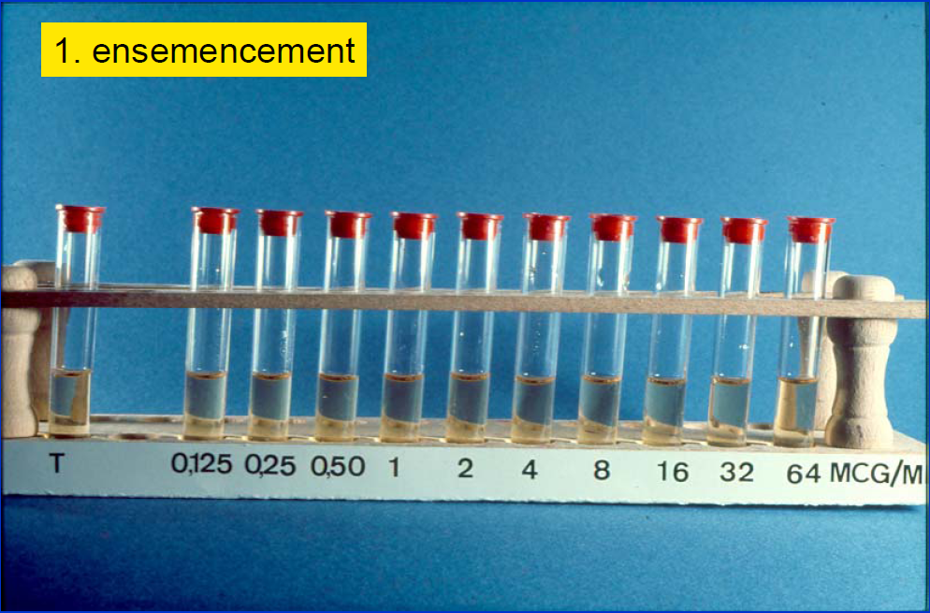
According to
Vincent Jarlier
IUD Mal Inf
Starting inoculum = 5.10⁵ to10⁶ Colony Forming Units per milliliter (CFU/mL)

Slide 7
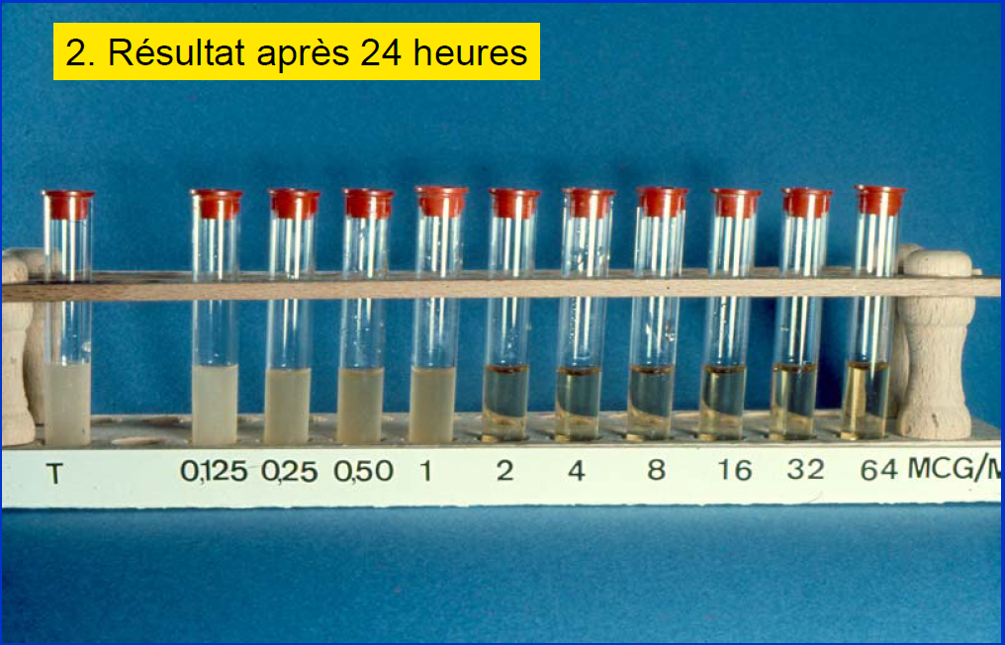
According to
Vincent Jarlier
IUD Mal Inf
MIC = 2 mg/L

Slide 8
Remark : MIC and disk diffusion
Regression line between MIC and diameter of diffusion
45
35
Diameters (mm)
MIC varying 1 to 4-fold for the same diameter
25
15
5
MIC(µg / ml)
Exemple : Penicilline G

Slide 9
MIC and disk diffusion
Susceptible
45
Major mistake
35
Diameters (mm)
Intermediare
25
Resistant
15
5
MIC (µg / ml)

Slide 10

MIC for combinations
Checkerboard assays
Antibiotic B
MIC B alone
MIC B when combined to A
0
MIC A
when combined to B
0
+
MIC A alone
Antibiotic A
Fractional Inhibitory Combination Index =
$$FICI= \frac{ {MIC}_{A when combined}}{{MIC}_{A alone }}+\frac{ {MIC}_{B when combined}}{{MIC}_{B alone }}$$
Here, FICI = 0.5 + 0.5 = 1

Slide 11

MIC for combinations
Checkerboard assays
$$FICI= \frac{ {MIC}_{A when combined}}{{MIC}_{A alone }}+\frac{ {MIC}_{B when combined}}{{MIC}_{B alone }}$$
If FICI< 0.5 => synergy
If FICI > 0.5 and <= 2 =>indifference
If FICI > or = 4 => antagonism

Slide 12
MBC
The MBC is the lowest concentrations allowing a decrease of 3 log₁₀ CFU/mL
The counts of bacteria at the end is unavoidable!
Two methods depending on the reliability of the initial inoculum
Method #1 with reliable inoculum of 5.10⁵ CFU/mL
Method #2 with unreliable inoculum

Slide 13
MBC
Method #1
From MIC wells or tubes, after overnight incubation, plate one drop of 5 -10 µL of each tube on nutritive agar, let it dry and incubate overnight at 35-37°C
If there are five colonies on the spot of 10 µL
there were 5 bacteria/10 µL in the well/tube = 500 bacteria/mL
If the inoculum for MIC of 5.10⁵ CFU/mL was reliable, it means that a reduction of more than 3 log₁₀ was reached => bactericidal activity.
The MBC corresponds to the lowest concentration with no more than five colonies in 10 µL (if the initial incoulum is reliable !)

Slide 14
MBC
Method #2
- Count precisely bacteria before and after MIC determination by performing serial 10-fold dilutions of the bacterial suspensions and by plating them (see next slides)
- Then, compare the counts before and after antibiotic exposure and determine the lowest concentration allawing a 3log₁₀ reduction = MBC

Slide 15
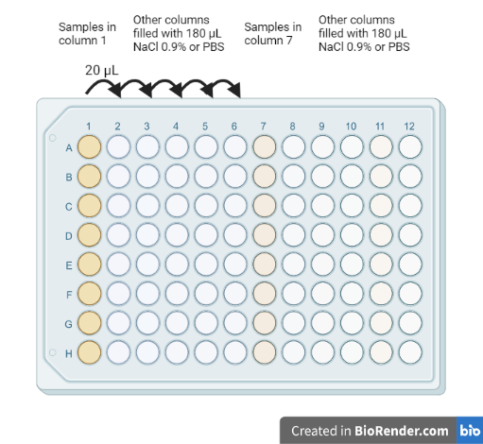
Serial ten-fold dilutions of the suspensions before and after MIC determination
From these wells, you can spread 100µL of each dilution on one agar plate per dilution.
It is very fastidious and poorly reproducible between operators!

Slide 16
Spots of the different dilutions from the 96-well plates on the agar and reading after incubation
Dilution factor
10⁰
10⁻¹
10⁻²
10⁻³
10⁻⁴
10⁻⁵
Spots of 10 µL each
Bacterial colony
= (4+3+4)/3
* 10³
* 10²
= 3.7.10⁵ CFU/mL
= mean of the spots with from 1 to 15 colonies
dilution factor
multiplication to have results in /mL instead of /10µL
*
*

Slide 17
ATB bactericidal or bacteriostatic
Bacteriostatic antibiotic: when MBC >> MIC
Bactericidal antibiotic: when MBC ~ MIC
Important remark !
A bacteriostatic antibiotic can have a bactericidal effect when C>> MIC
A bactericidal antibiotic can have a bacteriostatic effect when C ~ MIC

Slide 18
PD assessment
by Time-Kill Curves (TKC)

Slide 19
Time-kill curves
Methods :
Tubes incubated at 35-37°C (depending on the strain)
Prepare inoculum (One or two hours without drug)
Add the drug
Take care of oxygenation
  Agitation
  Volume of liquid
  Ventilated cap
Serial samplings of the same tube (100 µL is enough for bacterial counts)
Removal from incubator for samplings must be short
0
0.5 MIC
1 MIC
2 MIC
4 MIC
8 MIC

Slide 20
Serial ten-fold dilutions of the sample
Remark : if there are too many bacteria >10⁷⁻⁸ CFU/mL, 10-fold dilutions in microwells will fail because bacteria remain stuck to the tips
Solution: make a pre-dilution in a larger volume before the microdilutions
Eg : 10 µL of the sample in 990 µl NaCl 0.9% or PBS

Slide 21
Spots of the different dilution from the 96-well plates to the agar
Dilution factor
10⁰
10⁻¹
10⁻²
10⁻³
10⁻⁴
10⁻⁵
Spots of 10 µL each
Bacterial colony
= (4+3+4)/3
* 10³
* 10²
= 3.7.10⁵ CFU/mL
= mean of the spots with from 1 to 15 colonies
dilution factor
multiplication to have results in /mL instead of /10µL
*
*

Slide 22
Time-kill curves
Prevention of drug carry-over on agar:
Washing of the samples
  Centrifugation = 3000 g for 10 min (T° depends on the bacteria)
  Removal of the supernatant (be careful of the remaining volume)
  Addition of the same volume of NaCl 0.9% or PBS
  vortex
Plates with active charcoal and/or cations
  Efficacy depends on the drug

Slide 23
Time-kill curves
Allows the detection of bacterial inoculum decay/re-growth phases as a function of time and antibiotic concentrations
Conc 1
CFU/ml
latency
Conc 2
phase of
bactericidal activity
phase of
regrowth
0
2
6
time (h)
24

Slide 24
Time-kill curves
Early phase: 0.5 h to 6-8 h
  informs about the mode of action of the antibiotic, by the temporal dynamics of the bacterial killing
Late phase: > 6-8 h
  bacterial regrowth
    degradation of the antibiotic
    adaptive tolerance
    selection of resistant mutants
    ...

Slide 25
Time-kill curves
Low inoculum
Medium inoculum
10¹⁰
10⁸
10⁶
10⁴
10²
Bacteria (CFU/mL)
0
5
10
15
20
Timr (h)
0
5
10
15
20
Time (h)
High inoculum
0
10¹⁰
0.5x MIC
How to quantify the influence of inoculum size?
10⁸
1x
2x
10⁶
4x
10⁴
8x
16x
10²
32x
0
5
10
15
20
Time (h)

Slide 26
Quantification of bacterial killing
No « official » methods, no consensus
Both the speed of effect and the global/total effect can be considered (depending on the mode of action of the ATB)
Calculation of the initial rate of bacterial killing
Calculation of the killing effect over time (hybrid result between rate and killing activity = how many? How fast?)

Slide 27

Rate of bacterial killing
No « official » methods, no consensus
Rate of killing can be calculated between 0-1 h, 0-3h, 0-6h,….
$$Rate= \frac{\log\left(bact_{counts}\right)at 3h−\log\left(bact_{counts}\right)at 0h}{3h}$$
Rate of killing = initial slope
Surviving bacteria
Expressed in (log CFU/mL)/h
Time

Slide 28
Low inoculum
Medium inoculum
10¹⁰
10⁸
10⁶
10⁴
10²
Bacteria (CFU/mL)
0
5
10
15
20
Timr (h)
0
5
10
15
20
Time (h)
High inoculum
0
10¹⁰
0.5x MIC
Calculation of the initial killing rates
10⁸
1x
2x
10⁶
4x
10⁴
8x
16x
10²
32x
0
5
10
15
20
Time (h)

Slide 29
Rate of bacterial killing
Low inoculum
Medium inoculum
7
High inoculum
6
5
4
Rate of killing = initial slope
Bactericidal rate
([log CFU/mL]/h)
3
Surviving bacteria
2
1
0
-1
0.001
0.01
0.1
-2
marbofloxacin
(µg/mL)
Time

Slide 30
Rate of bacterial killing
Concentration dependent
(and time dependent)
(Non concentration dependent)
that are time-dependent
Surviving bacteria
Surviving bacteria
6 h
Time
6 h
Time
30

Slide 31
Classification of antibiotics
Concentration-dependent antibiotics
  their bactericidal rate increases with the concentration of the antibiotic
Time-dependent antibiotics
(also called non concentration-independent)
  as soon as they are bactericidal, the time-dependents act at their maximum speed (which is slow)

Slide 32
Classification of antibiotics
Concentration-dependent antibiotics
  Aminosides
  Quinolones (except on some gram-positive)
Time-dependent antibiotics
(also called non concentration-independent)
  Beta-lactams (except on some gram-negative)
  Cephalosporins
  Macrolides
  Tetracyclines

Slide 33
Quantification of bacterial killing
The easiest way to summarize an effect over time is the calculation of the Area Under the Curve
Each curve will be summarized by one number (in log(CFU/mL)xh)
log CFU/mL
AUC [0-8] without drug
=control
AUC[0-8] with drug
=ATB
How to calculate AUC?
Time
8 h

Slide 34
Quantification of bacterial killing
How to calculate AUC?
$${AUC}_{tot}={AUC}_{0−1}+{AUC}_{1−4}{+ AUC}_{4−8}{+ AUC}_{8−24}$$
Count 0
${AUC}_{0−1}=({time}_{1}−{time}_{0})×\frac{{\log{(bact_}count}_{0})+{ (\log{(bact_}count}_{1})}{2}$
Count 1
Count 4
Average log count between 0 and 1h
log CFU/mL
Count 8
Count 24
0
1
4
8
24
Time

Slide 35

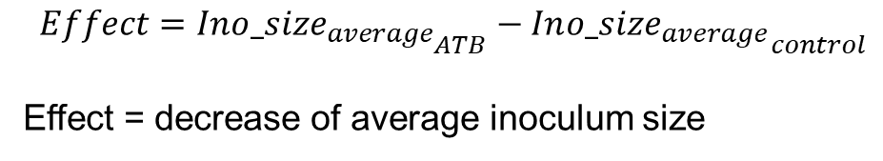
Quantification of bacterial killing
No « official » methods, no consensus
AUC can be calculated over 8, 24, 48h,….
Several calculations can be proposed from AUC
log CFU/mL
AUC [0-8] without drug
=control
$$Effect= \frac{{AUC}_{\left(0−8\right)ATB}}{8}−\frac{{AUC}_{\left(0−8\right)control}}{8}$$
$$Effect={In{o_size}_{average}}_{ATB}−{In{o_size}_{average}}_{control}$$
Effect = decrease of average inoculum size
AUC[0-8] with drug
=ATB
Time
8 h

Slide 36

Quantification of bacterial killing
No « official » methods, no consensus
AUC can be calculated over 8, 24, 48h,….
Several calculations can be proposed from AUC
log CFU/mL
AUC [0-8] without drug
=control
$$Effect\left(\%\right)=100×(1−\frac{{AUC}_{\left(0−8\right)ATB}}{{AUC}_{\left(0−8\right)control}})$$
AUC[0-8] with drug
=ATB
Time
8 h

Slide 37
Low inoculum
Medium inoculum
10¹⁰
10⁸
10⁶
10⁴
10²
Bacteria (CFU/mL)
0
5
10
15
20
Timr (h)
0
5
10
15
20
Time (h)
High inoculum
0
10¹⁰
0.5x MIC
Calculation of the global effect
10⁸
1x
2x
10⁶
4x
10⁴
8x
16x
10²
32x
0
5
10
15
20
Time (h)

Slide 38

Quantification of bacterial killing
$$Effect\left(\%\right)=100×(1−\frac{{AUC}_{\left(0−8\right)ATB}}{{AUC}_{\left(0−8\right)control}})$$
Low inoculum
Medium inoculum
High inoculum
100%
80%
log CFU/mL
AUC [0-8] without drug
=control
60%
Bactericidal effect (%)
40%
20%
AUC[0-8] with drug
=ATB
0%
Time
0.001
0.01
0.1
8 h
marbofloxacin (µg/mL)

Slide 39
Time-kill curves
Main factors that can influence the shape of the curve (~the activity of the drug)
  Exponential growth or latency
  Growth rate (depends on conditions and nutrients)
  Inoculum size

Slide 40
Time-kill curves
10¹⁰
Latency
10⁸
Influence of the growth rate on the bactericidal rate
10⁶
10⁴
10²
0
5
10
15
20
25
6
Time (h)
5
Latency
4
Exponential growth
Exponential growth
10¹⁰
0
6
0.5 MIC
3
10⁸
Bactericidal rate (log CFU/h)
1
2
1
10⁶
2
0
CFU/mL
4
0.001
-1
0.01
0.1
1
10⁴
8
-2
16
Marbofloxacin (µg/mL)
10²
32
0
5
10
15
20
25
Time (h)

Slide 41
PK/PD approach
Modelling

Slide 42
PK/PD indices
PK
PD
AUC
Cmax
T>Conc
summarize by
summarize by MIC
Plasma concentrations
Time
One value for the PK/PD indice
Comparison to the targeted value predicting efficacy

Slide 43
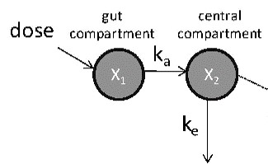
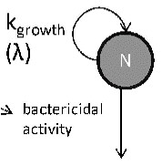
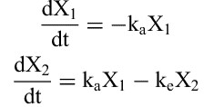


PD
PK
Plasma concentrations
Bacterial counts
Time
time
Concentrations over time are described by differential equations
The evolution of bacterial counts over time is also described by equation

Slide 44
PK/PD approach
In vitro dynamic systems

Slide 45
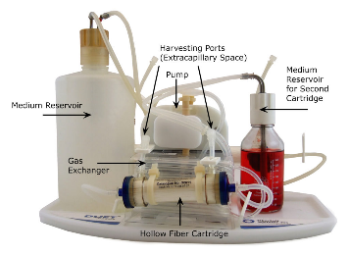
Static vs dynamic systems
MIC
concentrations
concentrations
time
time
Representative of infusions?
TKC

Slide 46
Dynamic systems
concentrations
time
Simulation of the concentration profiles (PK ) over several days
Bacterial counts over time by serial samplings

Slide 47
PK/PD approach
In vitro dynamic systems
« Opened » systems
samples
pump
Thermostat
37°C
waste
broth
broth + bacteria+ antibiotic
Magnetic stirrer
Water bath

Slide 48
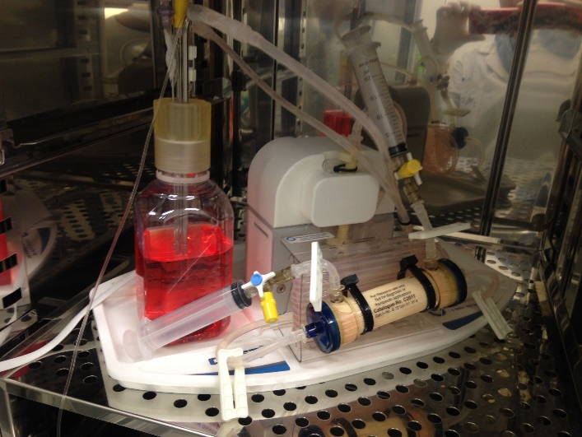
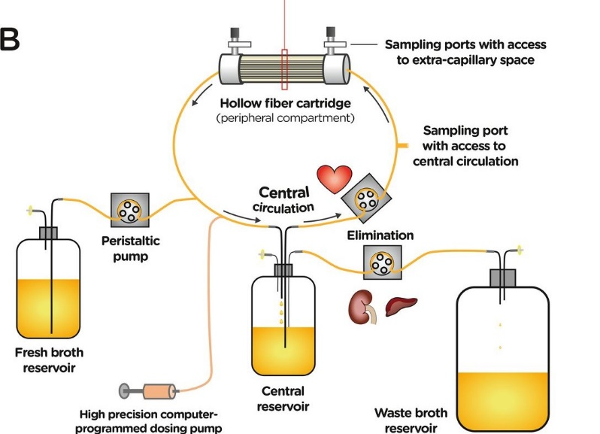
PK/PD approach
In vitro dynamic systems
Simultaneous simulation of the PK and observation of bacterial counts (PD)
Drug
in/out
bacteria
retained in the cartridge
drug
Extracapillary
space
Hollow Fiber suface

Slide 49

Hollow Fiber Infection Model
Cartdrige
Bacteria
P. aeruginosa PAK
Ciprofloxacin ( )
in/out
Extracapillary
space
Hollow Fiber suface
Ciprofloxacin
= systemic admin
ref
Tested conditions
Ciprofloxacin
Simulation of 400 mg q12h for 3 days
C_{max}= 1.5 µg/mL
T_{1/2} = 4h

Slide 50
Selection of mutants resistant to ciprofloxacin
Legend
Total bacteria
Bacteria with lower susceptibility to ciprofloxacin
Ciprofloxacin administrations

