Slide 1
Renal clearance
Aude Ferran
August 2021, Padova, Italy

Slide 2
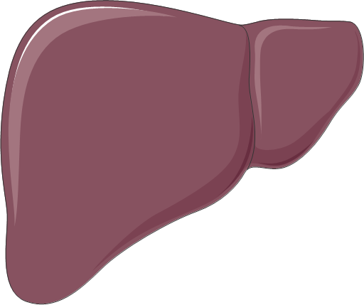
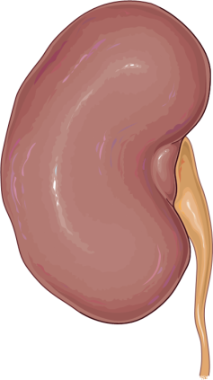
Introduction
Hydrophobic molecule
Hydrophilic molecule
Liver
Kidneys
More hydrophilic metabolite
Urine

Slide 3
Note : relation between lipophilicity and renal clearance
Introduction
10
Beta-blockers
NSAIDs
1
Renal clearance (mL/min/kg)
0.1
0.01
0.001
-3
-2
-1
0
1
2
Log D pH= 7.4
Smith, 1996, Med. Res. Rev.

Slide 4
Note : relation between lipophilicity and renal clearance
Introduction
Carboxylic acids
15
Renal clearance
Hepatic clearance
10
Renal clearance (mL/min/kg)
5
0
-1
0
Log D
1
2
Smith, 1996, Med. Res. Rev.

Slide 5
Renal clearance
Introduction
Physiological mechanisms and clearance
Glomerular filtration
Tubular secretion
Reabsorption
Methods to measure renal clearance

Slide 6
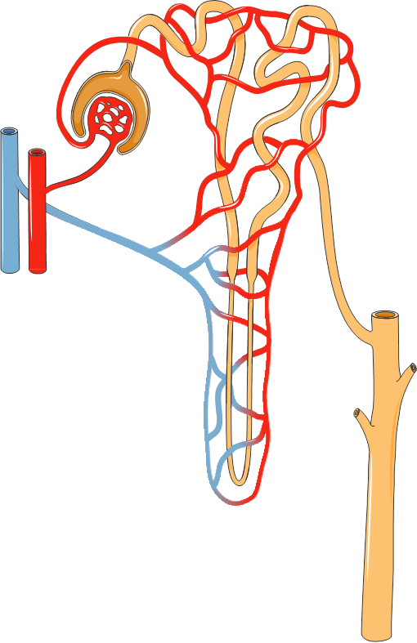
Processes of elimination, secretion and reabsorption occur at the nephron’s level
Introduction
Scheme of a nephron and its vascularisation

Slide 7
Physiological mechanisms
Filtration
Reabsorption (passive)
Proximal tubule
Distal tubule
Collecting tube
Glomerulus
Secretion
(active)
Loop of Henle
Scheme of a nephron

Slide 8
Physiological mechanisms
To urine
To plasma
Rate_{renal elimination}= Rate_{filtration} + Rate_{secretion} - Rate_{reabsorption}
Rate_{renal elimiationn} Rate_{filtration} Rate_{secretion} - Rate_{reabsorption}
=
+
C
C
C
Cl_{Renal} = Cl_{filtration} + Cl_{secretion} - Cl_{reabsorption}

Slide 9
Physiological mechanisms
Cl_{Renal} = Cl_{filtration} + Cl_{secretion} - Cl_{reabsorption}

Slide 10
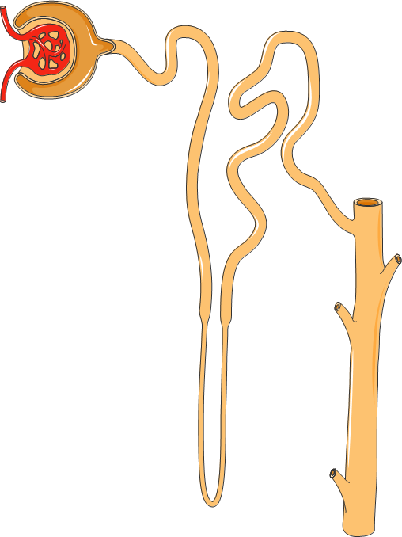
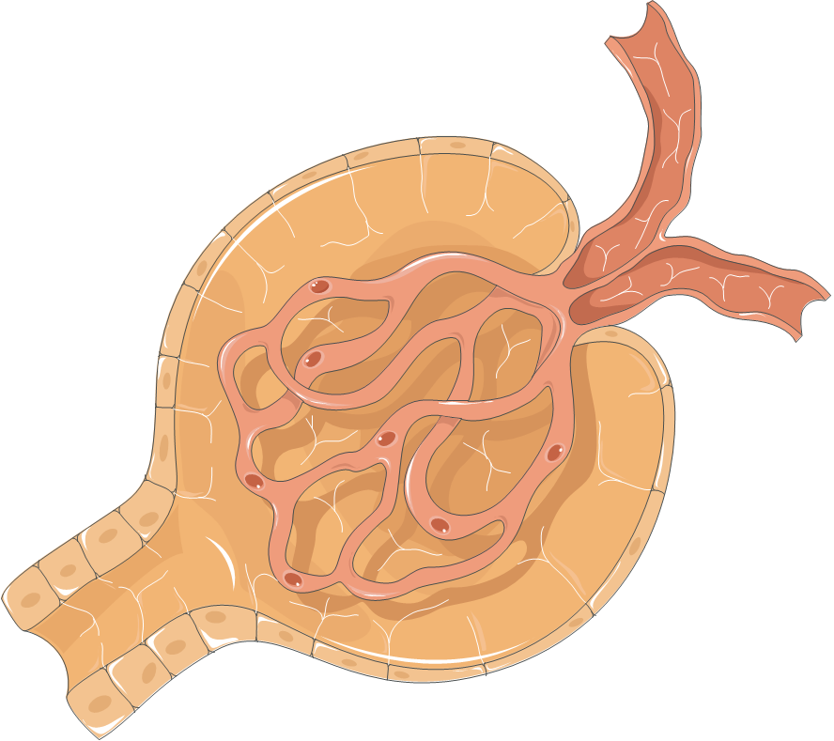
Physiological mechanisms
Glomerular filtration
FLOW RATES
Renal blood flow: 20-25% of cardiac output
Glomerular Filtration Rate (GFR): 10% of renal blood flow
GFR

Slide 11
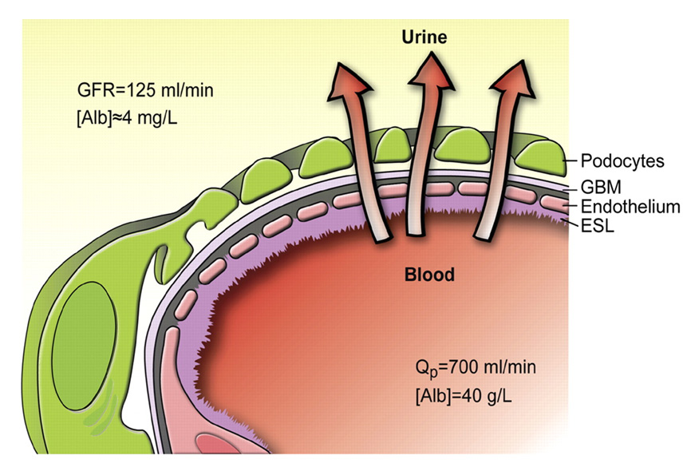
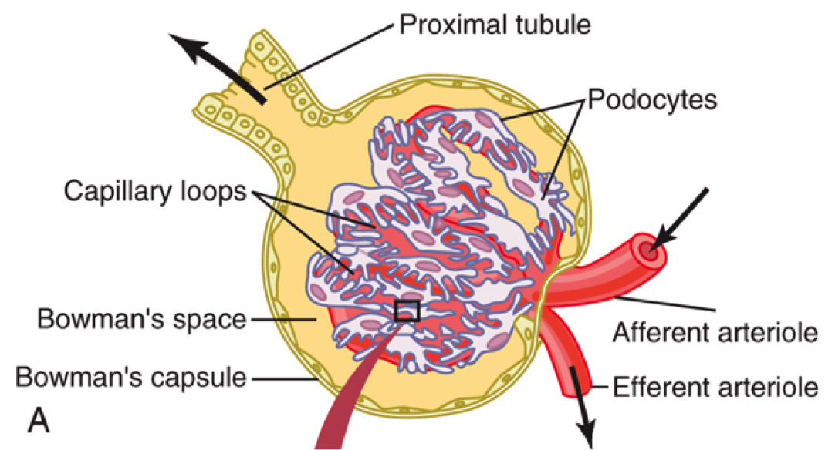
Physiological mechanisms
Glomerular filtration
= ULTRAFILTRATION
Albumin = 0.004 g/L
Passive mechanism
Molecules of MW < 68 kDa
Only the free fraction is filtered
Albumin = 40g/L
Haraldsson et al, Physiol Rev 88: 451-487, 2008

Slide 12
Physiological mechanisms
Glomerular filtration
The main factor that determines filtration is the molecular weight of the substance
Inulin
100
Myoglobin
Ultrafiltration/plasma
(%)
Albumin
50
0
20000
69000
PM(da)

Slide 13
Physiological mechanisms
Glomerular filtration
Rate_{filtration} = GFR x C_{free}
C_{free} = f_{u} x C_{tot}
Rate_{filtration} = GFR x f_{u} x C_{tot}
$${Cl}_{filtration}= \frac{{Rate}_{filtration}}{C_{tot}}=\frac{f_{u}×C_{tot}×GFR}{C_{tot}}=f_{u}×GFR$$
$${Cl}_{filtration}{=f}_{u}×GFR$$

Slide 14
Physiological mechanisms
Glomerular filtration
Estimated filtration capacity
If
Cl_{Renal} = Cl_{filtration}
There is only filtration in kidney
Q_{Renal} x E_{Renal} = f_{u} x GFR
$$E_{Renal}=\frac{GFR}{Q_{Renal}}$$
And if f_{u} = 1
Filtration alone can purify
at maximum 10% of renal blood flow

Slide 15
Physiological mechanisms
Glomerular filtration
Application
Measurement of GFR
Assessment of renal function
Conditions
Molecule with only renal elimination
Molecule filtered, not secreted, not reabsorbed
No binding to plasma proteins
$${Cl}_{Renal}={Cl}_{Total}=GFR$$

Slide 16
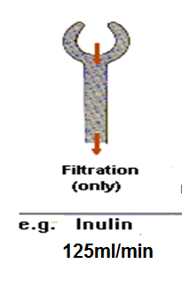
Physiological mechanisms
Glomerular filtration
Conditions
Molecule with only renal elimination
Molecule filtered, not secreted or reabsorbed
No binding to plasma proteins
INULINE or creatinine
Completely filtered (no binding to plasma proteins)
Not reabsorbed
Not secreted
Cl_{total_inu or creat} = GFR
in humans

Slide 17
Physiological mechanisms
Cl_{Renal} = Cl_{filtration} + Cl_{secretion} - Cl_{reabsorption}

Slide 18
Physiological mechanisms
Tubular secretion
Secretion
(active)
FEATURES
Proximal Convoluted Tubule (PCT)
Active Transport
Saturable process
= possible competition

Slide 19
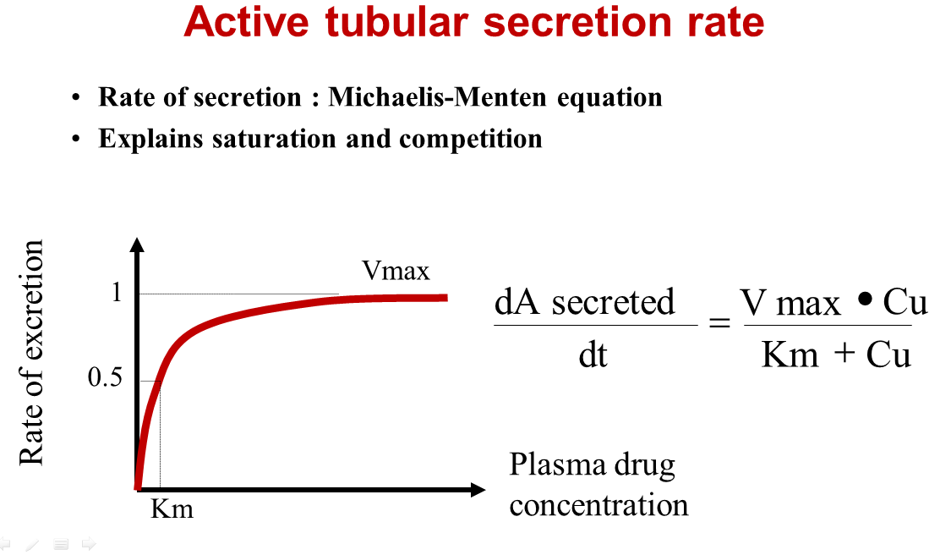
Physiological mechanisms
Tubular secretion
Examples
PAH
Penicillins
Salicylate
Sulfonamides
Furosemide
Thiazides
Cephalosporins
Fluoroquinolones
Note : secretion of penicillin can be limited by concomitant administration of probenecid

Slide 20
Note: examples of molecules with different renal extraction coefficient
Physiological mechanisms
Tubular secretion
If E_{renal} higher than 0.1 => there is a secretion
Low (<0.3) | Medium (0.3-0.7) | High (>0.7)
Amoxicillin | Cimetidin | Glucuronides
Digoxin |  | Sulfates
Gentamicin
Tetracycline

Slide 21
Physiological mechanisms
Tubular secretion
PAH ParaAminoHippuric acid
Filtered
And completely secreted by the TCP
=>E_{renal}=1
=>PAH clearance is equal to renal plasma flow
= Method to estimate the renal plasma flow
in humans

Slide 22
Physiological mechanisms
Cl_{Renal} = Cl_{filtration} + Cl_{secretion} - Cl_{reabsorption}

Slide 23
Physiological mechanisms
Reabsorption
ACTIVE (proximal convoluted tubules)
Transporters / endogenous compounds
Organic molecules: glucose, amino acids, vitamins
Electrolytes : Na⁺,Cl ⁻, Ca⁺⁺, K⁺, HCO₃⁻
PASSIVE
Water follows Na⁺ (concentration of primary urine in final urine)
Xenobiotics

Slide 24
Physiological mechanisms
Reabsorption
Individual factors
urine output
urine pH
Xenobiotic
Factors influencing reabsorption
Physico-chemical properties of the drug
lipophilicity
ionization
molecular weight

Slide 25
Physiological mechanisms
Reabsorption
Influence of the urinary pH
Rate of elimination
urine pH
5 6 6.5 8 8.5
-
(AH =reabs)
+
(A⁻ = no reabs)
Weak acids
+
(BH⁺= no reabs)
-
(B= reabs)
Weak Bases

Slide 26
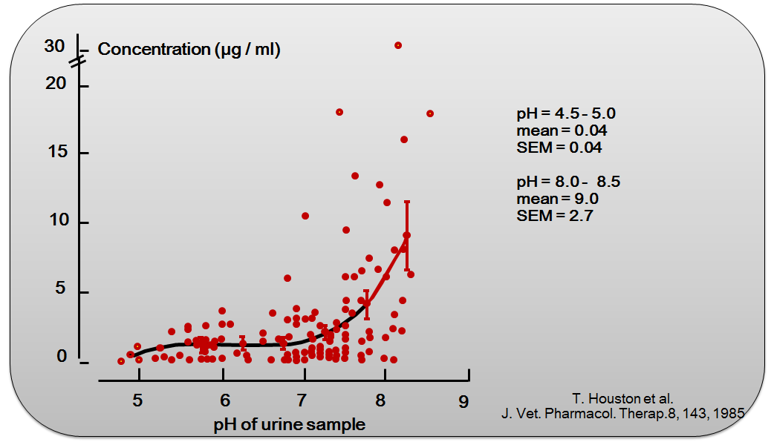
Phenylbutazone urine concentrations of horses at different pH

Slide 27
Physiological mechanisms
Summary: different combinations
Inulin
100
Sulfanilamide
95
Ampicillin
90
Sulfamethizole
20
Cephalexin
80
123
444
134
40
21
246
100
55
224
122
278
Kamiya et al. J Pharm Sci, 1983, 72:440
Provided values are normalized for inulin glomerular filtration

Slide 28
Methods of measurement
Collection of urine
$${Cl}_{Renal}=\frac{∆X_{u}/∆t}{C_{average,∆t}}$$
Plasma collection

Slide 29
Methods of measurement
Application to GFR measurement by creatinine
Conc
Plasma collection
Cmean_{, T}
X_{U} / T
Collection of urine
time

Slide 30
Methods of measurement
Plasma collection
Collection of urine
$${Cl}_{Renal}=\frac{∆X_{u}/∆t}{C_{average,∆t}}$$
Conc
AUC
time
Collection of urine
X_{U}

Slide 31
Summary
GFR
f_{u}
Active transports
Passive (ionization)
Cl_{Renal} = Cl_{filtration} + Cl_{secretion} - Cl_{reabsorption}

