Slide 1
PK/PD of antibiotics Dosage regimens and antimicrobial resistance
Alain Bousquet-Mélou
Padova, August 2021

Slide 2
Optimized antibiotic therapy: what objectives?
Maximum effectiveness against pathogenic bacteria
Minimising the emergence and selection of bacterial resistance
For target pathogens: efficacy/animal health issues

Slide 3
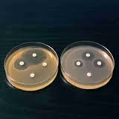
Antibiotic therapy and pharmacokinetic/pharmacodynamic (PK/PD) relationships
With the recommended dosage
Antibiogram: S
Area24h under the curve / MIC (AUC24h / MIC)
Peak / MIC (Cmax /MIC)
Concentrations
MIC
Time > MIC ( f T > MIC )
Time

Slide 4
Antibiotic therapy and pharmacokinetic/pharmacodynamic (PK/PD) relationships
With the recommended dosage
Antibiogram: R
AUC24h / MIC
Peak / MIC
MIC
concentrations
Time > MIC
Time

Slide 5
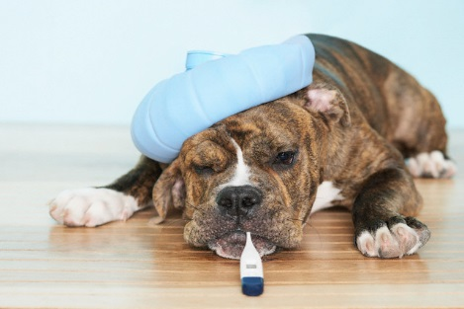
A bacterial infection evolves over time
Trigger
of the
disease
Health
Disease
No symptom
Symptoms
Contamination by the pathogenic bacteria / Weakened immune system
Growth of the initial inoculum

Slide 6
Different bacterial loads depending on the time of intervention during the infection
Disease
No symptom
Symptoms
Prophylaxis
Curative treatment
Metaphylaxis
Strong
Bacterial load (infection site)
No
Low

Slide 7
Optimized antibiotic therapy: what objectives?
Maximum effectiveness against pathogenic bacteria
Minimising the emergence and selection of bacterial resistance
For target pathogens: efficacy/animal health issues
High bacterial loads (inoculum) are heterogeneous

Slide 8
Large inocula are heterogeneous
Resistant mutant
"Age of infection
Susceptible wild-type strain
Antibiogram: S

Slide 9
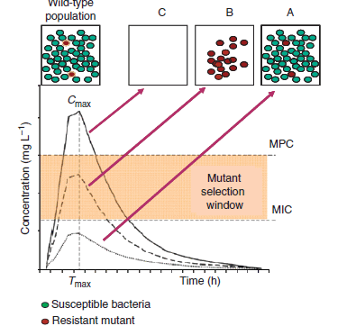
Selection or prevention of resistance: the notion of a selection window
Fluoroquinolones: Resistances appear by mutation (10-8 -10-9) on the genes coding for the targets of the antibiotics (gyrases, topoisomerases)
High Doses
ESPECIALLY WHEN
deficits in host defences

Slide 10
Consequences for doses
Kesteman, AAFC, 2009:
In vivo: lung infection
Bacteria: Klebsiella pneumoniae
Antibiotic: marbofloxacin
Later treatment
10⁹ CFU
100
80
70%
Higher doses
50%
60
% of rats with resistant KP in lungs
40
20
0%
0
16 mg/kg
100 mg/kg marbofloxacin
64 mg/kg
Notes:
No resistant bacteria were detected after early treatment while r bacteria were found at the same dose

Slide 11
Efficacy indices: clinical validation
Pulmonary infections (nosocomial) treated with IV ciprofloxacin
AUC/CMI strongly predictive of % bacterial eradication and time to achieve it
AUC/CMI>125: very high % eradication
AUC/CMI>250: eradication achieved on the first day of treatment
100
Higher doses
AUC/CMI < 125
% patients remaining culture positive
50
AUC/CMI 125-250
AUC/CMI > 250
0
4
8
12
Days after start of therapy
Schentag Symposium, 1999

Slide 12
The importance of treating early

Slide 13
Early treatment / Inoculum size / Selection of resistant mutants
Treatment onset / Standard dosage
evolution of the infection
Risk of selection of resistant clones
Susceptible
Resistant mutant

Slide 14
Early treatment / Inoculum size / Selection of resistant mutants
Treatment onset / Standard dosage
evolution of the infection
No risk of selection of resistant clones
Susceptible
Resistant mutant

Slide 15
Consequences for doses
Kesteman, AAFC, 2009:
In vivo: lung infection
Bacteria: Klebsiella pneumoniae
Antibiotic: marbofloxacin
Early treatment
¹⁰⁵ CFU
Later treatment
¹⁰⁹ CFU
100
80
70%
Higher doses
60
% of rats with resistant KP in lungs
or
40
20
Doses earlier
0%
0
16 mg/kg
100 mg/kg marbofloxacin
64 mg/kg
Notes:
No resistant bacteria were detected after early treatment while r bacteria were found at the same dose

Slide 16
The importance of treating early
Reducing the risk of resistant mutants selection

Slide 17
Early treatment / Inoculum size / Tolerant bacteria
Treatment onset / Standard dosage
evolution of the infection
Handb Exp Pharmacol. 2012;(211):121-33.
Persister cells: molecular mechanisms related to antibiotic tolerance.
Lewis K.
Risk of relapse: evolution towards chronicity
Sensitive
Tolerant bacteria

Slide 18
Early treatment / Inoculum size / Tolerant bacteria
Treatment onset / Standard dosage
evolution of the infection
Success / No evolution towards chronicity
Susceptible WT
Tolerant bacteria

Slide 19
The importance of treating early
Reducing the risk of resistant mutants selection
Avoid the presence of tolerant bacteria ("persisters")

Slide 20
Resistant vs. tolerant bacteria
During treatment
After the end of treatment

Slide 21
Large inocula are heterogeneous
Resistant mutant
"Age of infection
Risk of selection of resistant clones
Susceptible wild-type strain
Biofilms
Risk of evolution towards chronicity
Tolerant bacteria

Slide 22
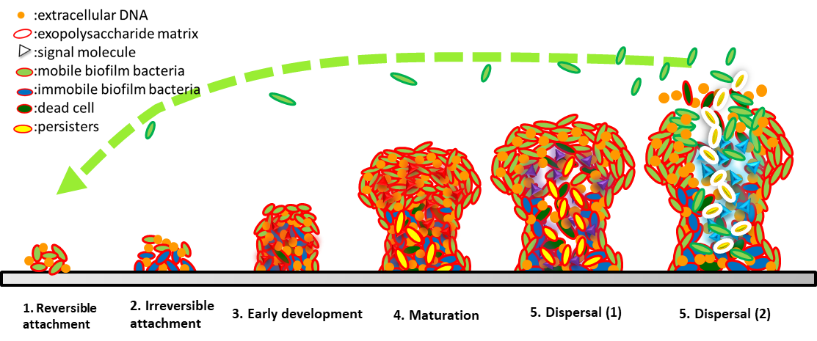
Large inocula are heterogeneous
Resistant mutant
"Age of infection
Risk of selection of resistant clones
Susceptible wild type strain
Risk of evolution towards chronicity
Tolerant bacteria

Slide 23
Large inocula are heterogeneous
Resistant mutant
"Age of infection
PROBABILISTIC ANTIBIOTICS INITIATED AS SOON AS POSSIBLE
Risk of selection of resistant clones
Susceptible wild-type strain
Risk of failure: evolution towards chronicity
Tolerant bacteria

Slide 24
To summarise
Treating Fast/Early with High doses is a good combination for :
Clinical cure
Prevention of resistances at the infection site
« Hit hard and fast … then leave as soon as possible »
Clinical cornerstone 2003 S3 (S21-S28)
« Hit hard and stop early »
Clinical Infectious Disease 2004

Slide 25
Optimized antibiotic therapy: what objectives?
Maximum effectiveness against pathogenic bacteria
Minimising the emergence and selection of bacterial resistance
For target pathogens: efficacy/animal health issues
For non-target bacteria: human health issues
Zoonotic bacteria
Animal commensal flora (reservoirs of resistance genes)

Slide 26
Veterinary antibiotics: critical bacterial flora
Oral antibiotic
Digestive tract
Resistant zoonotic pathogens
(Salmonella, Campylobacter)
Commensal flora (resistance genes)
Foodborne infection
Resistance gene pool
X ?
Parenteral antibiotic
Blood
Food chain
Environment
MEN
Pathogen of veterinary interest
5
5
ANIMAL HEALTH
PUBLIC HEALTH
26
Notes:
At the beginning of the breeding process, an atb is administered to target a lung infection in the animal, for example
Eradicates pathogenic bacteria and thus helps to maintain animal health
Indication: bacterial infection treatment
The problem is that ATB does not only act on the lung
Transiting to the distal part
Critical flora because it contains large bacteria that are very well adapted to their environment and can easily acquire and exchange R
All bacteria can become R
Most of them are not pathogenic, they are not directly dan but they constitute a potential reservoir through the food chain or the envy to other bacteria that may be pathogenic
In this example, the atb comes into direct contact with the bacteria because it is ad
If you take it through the bloodstream, it gets into the bloodstream and then reaches the lung. The problem is that often the atb will still reach the ig by secretion through the pith or through the bile
This access to antibiotics is unavoidable t The use of antibiotics is controversial as any use of antibiotics can lead to R in humans
There is no obvious solution and the team's objective is to reflect on how best to preserve public health based on the context

Slide 27
Antibiotics in animals
AB oral route
Intestinal microbiota
Zoonotic pathogens (Salmonella,
Campylobacter)
Commensal flora (resistance genes)
Unfavourable
AB parenteral route
Blood
« Hit hard »
Veterinary Pathogen
ANIMAL HEALTH
Favourable
27

Slide 28
What strategy to preserve commensal flora?
Duration of treatment
Selection pressure

Slide 29
What strategy to preserve commensal flora?
Lack of clinical trials in veterinary medicine that validate treatment durations
Duration of treatment = EMPIRICAL CHOICE
"the precise duration of treatment is not supported by solid evidence »
"not enough controlled clinical trials »
according to the World Health Organization

Slide 30
What strategy to preserve commensal flora?
Impact of treatment duration on clinical success
FLUOROQUINOLONE, BETA-LACTAM, MACROLIDE
Treatment of acute exacerbations of chronic bronchitis
5 days of treatment = 7-10 days of treatment
Falagas et al. JAC 2008:62 442-450
FLUOROQUINOLONE (levofloxacin)
Treatment of pneumonia
Dunbar et al. CID 2003:37 752-760
750 mg
for 5 days
=
500 mg
for 10 days

Slide 31
What strategy to preserve commensal flora?
Impact of treatment duration on clinical success
AMOXICILLIN - AC CLAVULANIC
Treatment of acute exacerbations of chronic bronchitis
After re-evaluation at 3 days: placebo or amox-clav 7 days
3 days of treatment = 10 days of treatment
Roede et al Clin Microb Infect 2007:13 284-290
RE-EVALUATIONS 3-5 DAYS FOR DECISION
RE-EVALUATIONS DURING TRANSITIONS :
Injectable / Oral
Leaving the hospital

Slide 32
What strategy to preserve commensal flora?
Impact of treatment duration on resistance emergence: commensal flora of the nasopharynx
AMOXICILLIN: 90 mg/kg for 5 d vs 40 mg/kg for 10 d
Isolation of penicillin-resistant S. pneumoniae from children less frequent
Schrag et al JAMA 2001:286 49-56
PENICILLIN: treatment duration greater than 5 days
Isolation of penicillin-resistant S. pneumoniae in children more common
Guillemot et al JAMA 1998:279 365-370

Slide 33
Antibiotics in animals
AB oral route
Intestinal microbiota
Zoonotic pathogens (Salmonella,
Campylobacter)
Commensal flora (resistance genes)
Favourable
AB parenteral route
Blood
short
duration
Veterinary Pathogen
« Hit hard »
ANIMAL HEALTH
33

Slide 34
Long-acting formulations should be questioned
Commensal flora
concentrations
Different duration of exposure
Threshold
The same "efficacious" time
Pathogenic inoculum
Time

Slide 35
To summarize
A favourable combination for :
Clinical cure
Prevention of resistances at the infection site
Prevention of resistances in commensal flora
« Hit hard and fast … then leave as soon as possible »
Clinical cornerstone 2003 S3 (S21-S28)
« Hit hard and stop early »
Clinical Infectious Disease 2004

