Slide 1


Basis of the PK/PD
(pharmacokinetic / pharmacodynamic) approach in antimicrobial therapy
Aude Ferran
Padova, August 2021

Slide 2
Optimized antibiotic therapy: what objectives?
Maximum efficiency against pathogenic bacteria
Minimize the emergence and selection of bacterial resistance
  For target pathogens: efficacy/animal health issues
  For non-target bacteria: human health issues

Slide 3
The objectives of a dosage regimen for a veterinary antibiotic
Animal health issues
To achieve a cure without adverse effects
Public health issues
To avoid the selection and amplification of resistance genes
Note: there can be a potential conflict between the two objectives

Slide 4
How to determine a dosage regimen ?
by establishing the relationship between doses and effects
Animal infection models
Clinical trials
PK/PD approach

Slide 5
PK/PD approach
= identifying and describing steps leading to an effect
Administered dose
of active ingredient
Therapeutic effect
ABSORPTION
Plasma
concentrations
Biophase/tissular
concentrations
ELIMINATION
DISTRIBUTION
PHARMACOKINETICS
PHARMACODYNAMICS

Slide 6
Active ingredient
administered
Plasma
concentrations
Efficiency
Biophase =
Infectious site
Pathogenic bacteria
Resistance selection
Elimination
PHARMACOKINETICS
PHARMACODYNAMICS

Slide 7
Zoonotic bacteria
Resistance selection
Active ingredient
administered
Biophase
Digestive tract
Resistance selection
(and other commensal flora)
Commensal bacteria
Break of the barrier against colonization
Plasma
concentrations
Efficiency
Biophase =
Infectious site
Pathogenic bacteria
Resistance selection
Elimination
PHARMACOKINETICS
PHARMACODYNAMICS

Slide 8
PK/PD approach
What information is needed?
Dose of active ingredient
administered
Therapeutic effect
in vitro
MIC
Rates of bacterial killing
ABSORPTION
in vivo
PK analysis
Plasma
concentrations
Biophase
concentrations
ELIMINATION
DISTRIBUTION
PHARMACOKINETICS
PHARMACODYNAMICS

Slide 9
Why plasma concentrations ?
Because they control the concentrations at the infection site = where pathogens are located

Slide 10
Where are the pathogens located?
Intracellular pathogens (mandatory)
Chlamydia
Rickettsia
Brucella
Lawsonia intracellularis
Rhodococcus equi
Most of pathogens are extracellular
Streptococcus pneumoniae
Escherichia coli
Klebsiella pneumoniae
Mannheimia haemolytica
Pasteurella multocida
Actinobacillus pleuropneumoniae
Mycoplasma hyopneumoniae
Bordetella bronchiseptica
Intracellular pathogens (optional)
Staphylococcus aureus
Escherichia coli
Salmonella typhi
Listeria
Mycobacterium tuberculosis
Streptococcus suis

Slide 11
The free plasma concentrations of the antibiotic control the concentrations of the extracellular biophase
ATB Bound
ATB free
ATB Bound
ATB Free
Bacteria
Diffusion/permeability
Blood
ECF = Extra Cellular Fluid
!!! EXCEPT if barriers !!!
Physiological: brain, prostate, eye (posterior chamber)
Pathological : clot, abscess, ...

Slide 12
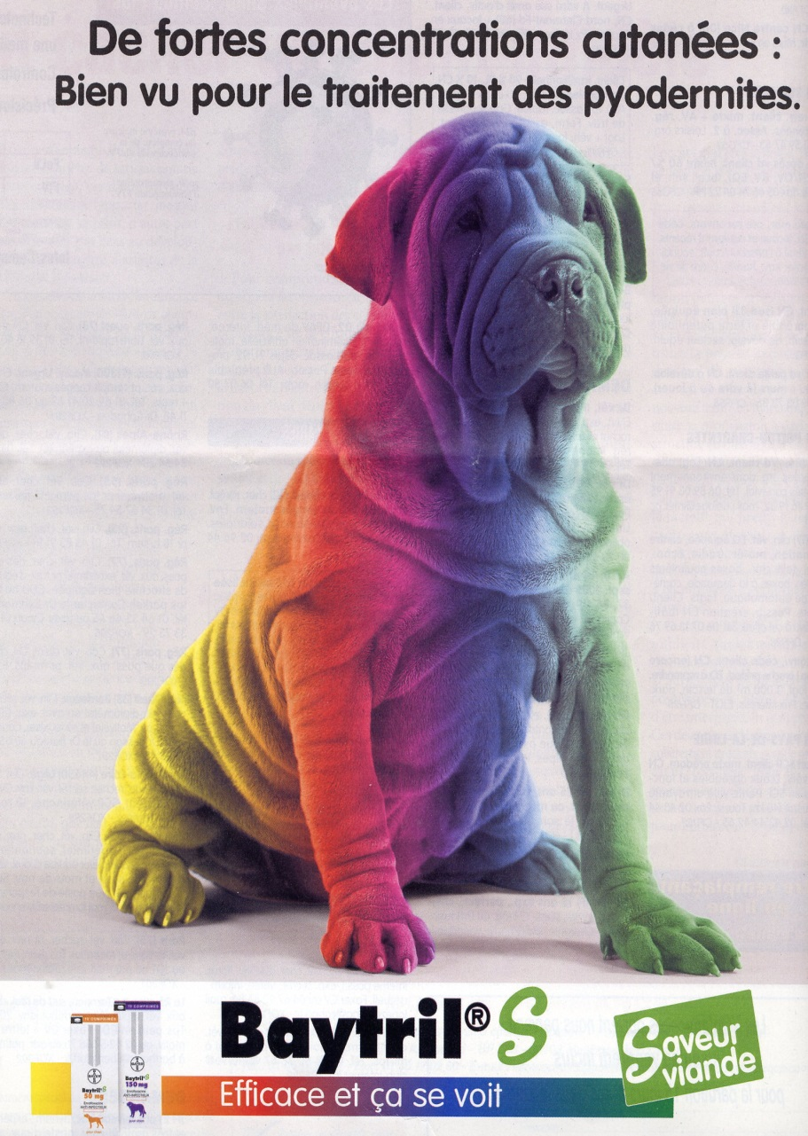
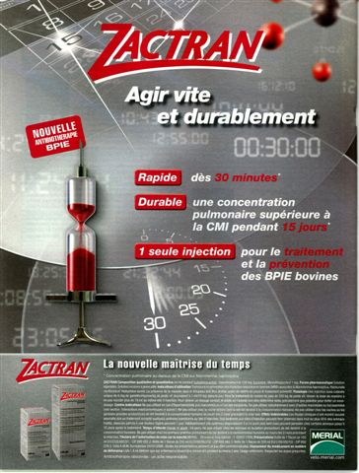
Tissue concentrations: relevant ... ?

Slide 13
Tissue concentrations
Tissue concentrations are derived from grinding = do not reflect the heterogeneity of extracellular and intracellular compartments
Free concentrations ECF = Free plasma concentrations
  Experimentally demonstrated with microdialysis studies
  Little or no change during inflammation

Slide 14
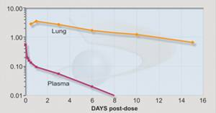
Tissue concentrations: relevant ... ?
How to explain the following situation, for bacteria with extracellular localization?
MIC₉₀

Slide 15
Tissue concentrations: ... or not?
MIC90
If only plasma concentrations are relevant, why does it work?
Because susceptibility measured in vitro does not reflect in vivo activity

Slide 16
Tulathromycin has anti-inflammatory and immunomodulatory properties

Slide 17
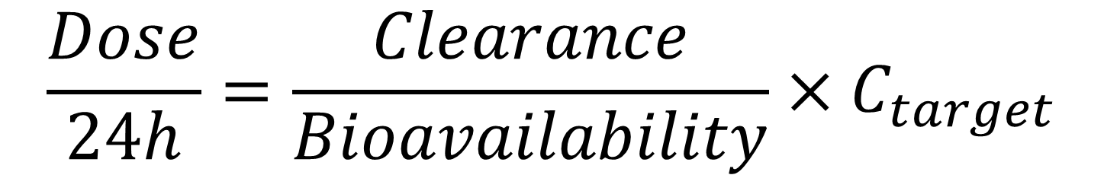
PK/PD approach
Calculation of a dose
Daily
dose
$$\frac{Dose}{24h}=\frac{Clearance}{Bioavailability}×C_{target}$$
Efficacious concentration
Pharmacokinetic parameters
which control
plasma concentrations
Knowledge of pharmacodynamics

Slide 18
Pharmacodynamic assessment for the PK/PD approach in antimicrobial therapy

Slide 19
Indicators of the effect of antibiotics on bacteria
In vitro
  MIC, MBC
  rate of bacterial killing
  post-antibiotic effect (PAE)
In vivo
  Clinical outcomes: bacteremia, hyperthermia, leukocytosis, survival/death,...
  PK/PD indices associated to a given outcome (eg: survival): AUC/MIC, C_{max}/MIC, T>MIC

Slide 20
MIC and MBC
MIC = minimum inhibitory concentration: smallest concentration of antibiotic that inhibits all visible growth of a bacterial strain after 18-24 hours of culture at 37°C.
This value characterizes the bacteriostatic effect of an antibiotic
MBC = lowest concentration of antibiotic leaving only 0.01% or less survivors of the initial inoculum after 18-24 hours of culture at 37°C.
This value characterizes the bactericidal effect of an antibiotic

Slide 21
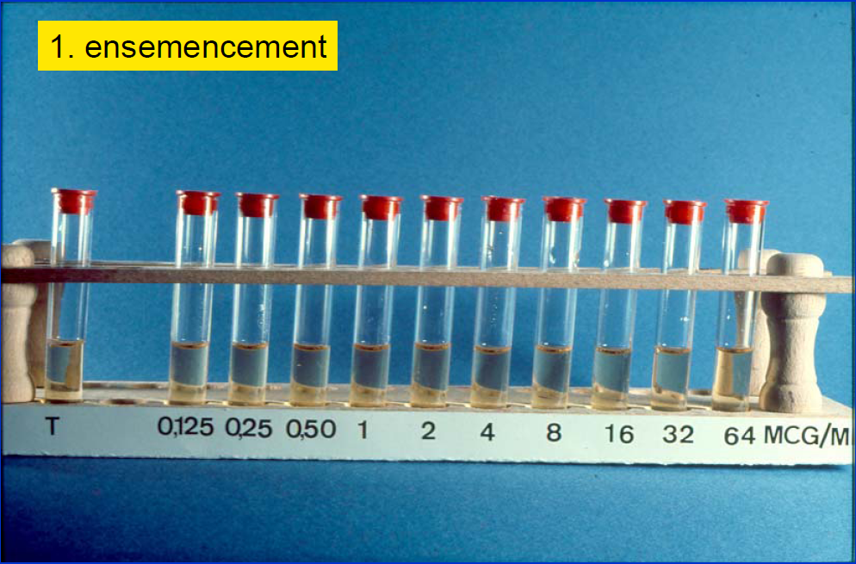
According to
Vincent Jarlier
IUD Mal Inf
Starting inoculum = 10⁶ Colony Forming Units per milliliter (CFU/mL)

Slide 22
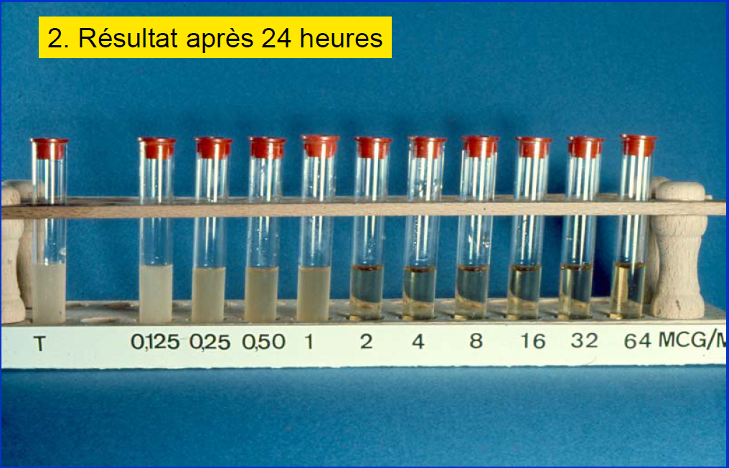
According to
Vincent Jarlier
IUD Mal Inf
MIC = 2 mg/L
MBC = 32 mg/L
Conc. AB (µg/mL)
2
4
8
16
32
64
Bacteria (CFU/mL)
¹⁰⁶
¹⁰⁵
¹⁰⁴
¹⁰³
¹⁰²
¹⁰¹

Slide 23
ATB bactericidal or bacteriostatic
ATB bacteriostatic: when MBC >> MIC
ATB bactericidal: when MBC ≥ MIC

Slide 24
Speed of bactericidal activity
- Obtained by monitoring the size of a bacterial population over time
- Early phase (6-8 h): allows to observe the influence of time and concentration on the size of the inoculum

Slide 25
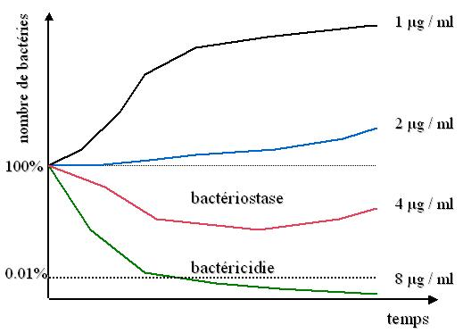
Rate of bacterial killing
Obtained by performing time-kill (or killing) curves
MIC
MBC
Allows to observe the influence of concentrations and time on the size of the bacterial population

Slide 26
Rate of bacterial killing
Allows the detection of bacterial inoculum decay/re-growth phases as a function of time and antibiotic concentrations
Conc 1
CFU/ml
latency
Conc 2
phase of
Bactericidal activity
phase of
regrowth
0
2
6
time (h)

Slide 27
Rate of bacterial killing
Early phase: 0.5 h to 6-8 h
  informs about the mode of action of the antibiotic, by the temporal dynamics of the bacterial killing
Late phase: > 6-8 h
  bacterial regrowth
    degradation of the antibiotic
    adaptive tolerance
    selection of resistant mutants
    ...

Slide 28
Rate of bacterial killing
Concentration dependent
(and Time dependent)
(Non concentration dependent)
that are time-dependent
Surviving bacteria
Surviving bacteria
6 h
Time
6 h
Time
28

Slide 29
Classification of antibiotics
Concentration-dependent antibiotics
  their bactericidal rate increases with the concentration of the antibiotic
Time-dependent antibiotics
(also called non concentration-independent)
  as soon as they are bactericidal, the time-dependents act at their maximum speed (which is slow)

Slide 30
Classification of antibiotics
Concentration-dependent antibiotics
  Aminosides
  Quinolones (except on some gram-positive)
Time-dependent antibiotics
(also called non concentration-independent)
  Beta-lactams (except on some gram-negative)
  Cephalosporins
  Macrolides
  Tetracyclines

Slide 31
The post-antibiotic effect (PAE) in vitro
Period of time without regrowth after removal of the antibiotic from the medium
PAE = time required for 1 log₁₀ growth after 1/100th dilution of the inoculum (compared to control)
PAE = T_{x10,ATB} - T_{x10,C}
with T_{x10,ATB} = time without regrowth with ATB
with T_{x10,C} = time without regrowth in control culture without ATB

Slide 32
The post-antibiotic effect (PAE) in vitro
Culture without ATB
Culture with ATB
8
T_{x10,C}
7
PAE
6
T_{x10,ATB}
Log₁₀ [CFU/mL]
5
4
3
2
0
2
4
6
8
10
12
Hours

Slide 33
The post-antibiotic effect (PAE) in vitro
PAE is influenced by the following factors:
  Bacteria species
  Type of antibiotic
  Concentration of the antibiotic
  Duration of exposure to the antibiotic
  Size of the inoculum
  Growth phase of the bacteria

Slide 34
The post-antibiotic effect (PAE) in vitro
The PAE reflects the persistence of the antibiotic action and is typically observed for antibiotics with an irreversible or slowly reversible action on bacterial syntheses
Mechanisms
  Persistence of the antibiotic at its binding sites
  Diffusion time outside the bacterium eg. Quinolones
  Regeneration time of the bacterial enzymes
  Regeneration time of ribosomes eg. Aminogycosides
  …

Slide 35
The post-antibiotic effect (PAE) in vitro
Effect
Betalactams
Tetracyclines
Chloramphenicol
Macrolides
Trimethoprim
Aminosides
Rifampicin
Gram +
++
+++
+++
+++
++
+
++++
Gram -
0
+++
+++
ND
+
++++
++++
0 = less than 0.5h + = 0.5 to 1.5h
++ = 1.5 to 2.5h +++ = 2.5h to 4h
++++ > 4h ND = not determined

Slide 36
The post-antibiotic effect (PAE) in vivo
In a treated animal, PAE is the period of time (h) required for the increase of bacteria by 1 log₁₀ at the infection site when plasma concentrations fall below the MIC
= The in vivo PAE is totally confounded with the sub-inhibitory effects of the antibiotic (i.e. the effects of the antibiotic when the concentrations are still below its MIC)

Slide 37
The post-antibiotic effect (PAE) in vivo
In vivo PAE is quantified in animal models of experimental infections
The in vivo PAE is:
  Correlated with PAE in vitro
  Longer than in vitro because of:
    Sub-inhibitory effects of the antibiotic at concentrations < MIC
    Interactions with the immune system

Slide 38
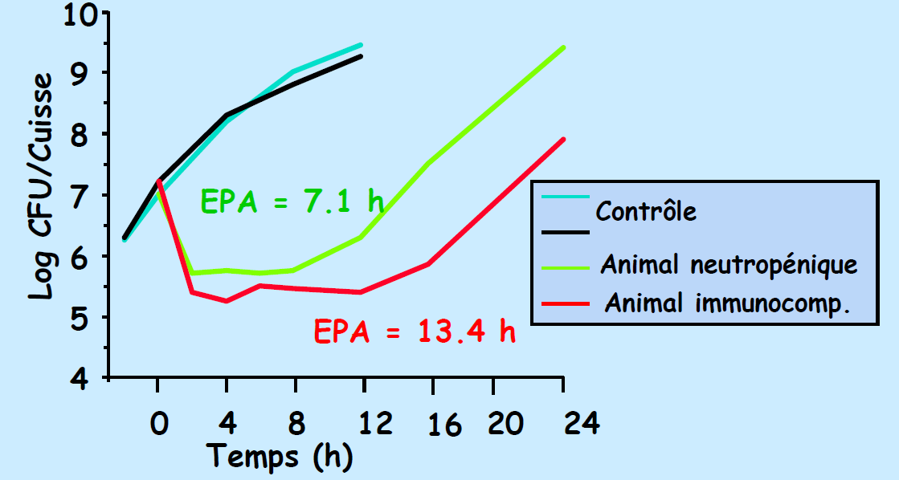
The post-antibiotic effect (PAE) in vivo
According to C. Padoin IUD Infection and Tropical Diseases

Slide 39
The post-antibiotic effect (PAE) in vivo
The role of PAE in therapeutic efficacy is discussed
  If the half-life of ATB is short (1 h), PAE can significantly prolong the effect
  If the half-life of AB is long (>5 h), the contribution of PAE is probably negligible

Slide 40
PK/PD indices

Slide 41
PK/PD indices (or efficacy indices)
Way to standardize plasma exposure, relative to pathogen susceptibility (MIC)
  Exposure in terms of Intensity and/or Duration
Threshold values of these indices "guarantee" the cure with a certain probability (usually 80-90%).

Slide 42
PK/PD indices
Intensity
Area24h under
the curve / MIC
(AUC_{24h} / MIC)
Peak / MIC
(C_{max} /MIC)
concentrations
MIC
Time > MIC (T > MIC)
Time
Duration

Slide 43
The PK/PD index best correlated with efficacy depends on the antibiotic class

Slide 44
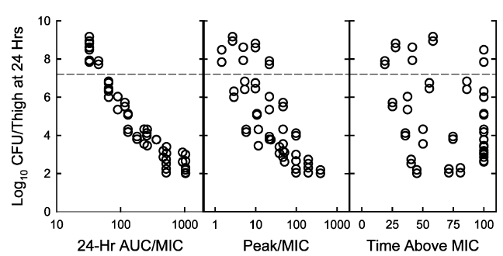
Relationship between 3 PK/PD indices and Streptococcus pneumoniae counts after 24 h of treatment with temafloxacin
Fluoroquinolone
Mouse model
Thigh infection
Neutropenic animals
Andes & Craig, Int J Antimicrob Agents, 2002

Slide 45
Relationship between 3 PK/PD indices and Klebsiella pneumoniae counts after 24 h of treatment with ceftazidime
Beta-lactam
Mouse model
Thigh infection
Neutropenic animals
Andes & Craig, Int J Antimicrob Agents, 2002

Slide 46
Antibacterial action | Antibiotic family | PK-PD index correlated with antibacterial action
Concentration-dependent, with significant PAE | Aminoglycosides | Cmax/MIC
 | Fluoroquinolones | AUC/MIC Cmax/MIC
 | Nitroimidazoles | AUC/MIC Cmax/MIC
 | Polymixins | AUC/MIC
Time-dependent, with or without PAE | Penicillins | T>MIC
 | Cephalosporins | T>MIC
 | Macrolides & triamilides | T>MIC or (AUC/MIC)
 | Lincosamides | T>MIC
 | Phenicols | T>MIC
 | Sulfonamides | T>MIC
 | Diaminopyrimidines | T>MIC
Both Time- and Concentration-dependent | Tetracyclines | AUC/MIC
 | Ketolides | AUC/MIC
 | Glycopeptides | AUC/MIC

Slide 47
PK/PD index values required to ensure maximum efficiency
Determination from animal models

Slide 48
Influence of the bacteria on the value of the PK/PD index
Cefazolin
For E. coli, no PAE
=>efficacy is maximal when T_{>MIC} > 80% of the dosing interval
For S. aureus, there is a PAE
=>efficacy is maximal when T_{>MIC} >50% of the dosing interval
E. coli
S. aureus
Mean Δ log₁₀ CFU per mouse over 24h
0
50
100
0
50
100
T _{> MIC} (% assay range)
Vogelman et al. 1988, J. Inf. Dis.

Slide 49
Influence of the immune system on the value of the PK/PD index
Neutropenic
Immunocompetent
Threshold value
Higher
Lower

Slide 50
PK/PD index values required to ensure maximum efficiency
Determination from clinical trials

Slide 51
Clinical validation
Bacteriological cure versus Time _{> MIC} when treating otitis media with beta-lactams (Craig and Andes 1996)
100
S. pneumoniae
Penicillin
cephalosporins
50
Bacteriologic cure (%)
H. influenzae
Penicillin
cephalosporins
0
0
50
100
Time above MIC (%)
fT_{>MIC} > 50% of the dosing interval to achieve bacteriological cure in 80% of patients

Slide 52
Clinical validation
Relationship between C_{max}/MIC ratio and clinical cure in 236 patients with Gram-negative infections treated with aminoglycosides (gentamicin, tobramycin, amikacin) (Moor et al. 1984 J. Infect. Dis)
100
80
Response rate (%)
60
.
2
4
6
8
10
12
Maximum peak/MIC ratio
fC_{max} > 8 to achieve bacteriological cure in 80% of patients

Slide 53
Clinical validation
Pulmonary infections (nosocomial) treated with ciprofloxacin IV
AUC/MIC was strongly predictive of
- the bacterial eradication and
- the time to achieve it
AUC/MIC>125: very high % eradication
AUC/MIC>250: eradication obtained on the first day of treatment
100
AUC/MIC < 125
% patients remaining culture positive
50
AUC/MIC 125-250
AUC/MIC > 250
0
4
8
12
Days after start of therapy
Schentag Symposium, 1999

Slide 54
Summary of validated critical values in human medicine
AUC / MIC : 125 h
Cmax / MIC : 8-10
T_{>MIC} :
  40 to 50% for Gram + bacteria
  60 to 80% for Gram - bacteria
These indices and their threshold values are used as indicators to predict whether a dosage will be associated with a high percentage of cure
Possible uses of these values
  To check if a given dosage allows to reach these thresholds for different MIC values
  To define in a rational way the administration scheme
  To calculate the dosage that will allow to reach these thresholds

Slide 55
Administration schemes
Antibacterial action | Antibiotic family | Antibiotic | PK-PD index correlated with antibacterial action
Concentration-dependent, with significant PAE | Aminoglycosides | Streptomycin, Neomycin, Gentamicin, Amikacin, Tobramycin | Cmax/MIC
 | Fluoroquinolones | Enrofloxacin, Danofloxacin, Marbofloxacin, Difloxacin, Ibafloxacin | AUC/MIC Cmax/MIC
 | Nitroimidazoles | Metronidazole | AUC/MIC Cmax/MIC
 | Polymixins | Colistin | AUC/MIC
Time-dependent, with or without PAE | Penicillins | Benzylpenicillin, Cloxacillin, Ampicillin, Amoxicillin, Carbenicillin | T>MIC
 | Cephalosporins | Ceftiofur, Cefalexin, Cefapirin | T>MIC
 | Macrolides & triamilides | Tilvalosin, Tylosin, Erythromycin, Tilmicosin, Tulathromycin | T>MIC or (AUC/MIC)
 | Lincosamides | Clindamycin | T>MIC
 | Phenicols | Chloramphenicol, Florphenicol | T>MIC
 | Sulfonamides | Sulfadoxine, Sulfadiazine | T>MIC
 | Diaminopyrimidines | Trimethoprim | T>MIC
Both Time- and Concentration-dependent | Tetracyclines | Oxytetracycline, Chlortetracycline, Doxycycline | AUC/MIC
 | Ketolides | Azithromycin, Clarithromycin | AUC/MIC
 | Glycopeptides | Vancomycin | AUC/MIC
Daily doses
high / unique
Daily doses
fractionated / infusion
or
(Very) long-action

Slide 56
Administration schemes
Example of a time-dependent antibiotic Objective: To maximize T_{>MIC}
120
100
80
Dose 1; τ = 24h
60
First proposal : 2 x Dose 1; τ = 24h
40
20
0
0
12
24
36
48
120
100
80
60
40
Dose 1; τ = 24h
20
Second proposal Dose 1; τ = 12h
0
0
12
24
36
48

Slide 57

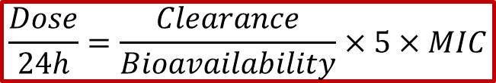
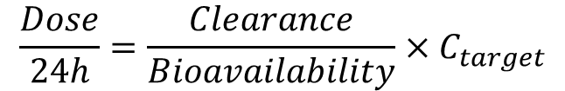



Calculation of the dose
Example: Calculation of the dose to reach AUC/MIC equal to 125
$$\frac{{AUC}_{24h}}{MIC}=125 h$$
$$\frac{C_{average}×24h}{MIC}=125 h$$
$$\frac{Dose}{24h}=\frac{Clearance}{Bioavailability}×C_{target}$$
$$C_{average}=\frac{125h}{24h}×MIC$$
$$C_{average,24h}=5×MIC$$
$$\frac{Dose}{24h}=\frac{Clearance}{Bioavailability}×5×MIC$$

Slide 58
To summarize
The PK/PD index correlated with efficacy:
  Is the same regardless of the infected host: animals, humans
  Depends on the killing rate of the antibiotic
    Exposure intensity (AUC/MIC, Cmax/MIC) for concentration-dependent antibiotics and
    Exposure duration (T>MIC) for time-dependent antibiotics
The PK/PD index values associated with a high probability of cure:
  Depends on various factors: bacteria (Gram+ vs Gram-), antibiotics (beta-lactams), infectious sites, hosts (immune system)
Knowledge of the type PK/PD indices correlated with efficacy allows optimization of dosing regimens:
    Maximize the intensity of exposure for concentration-dependent antibiotics
    Maximize the duration of exposure for time-dependent antibiotics

