Slide 1


PK/PD and medication/doping control in horses : the EU approach or A PK/PD approach to propose irrelevant plasma or urine drug concentrations for medication/doping control
Pierre-Louis Toutain
Visiting Professor
Royal Veterinary College , London
7 July 2018
Australian & New Zealand College of Veterinary Scientists
QT Gold Coast, Surfers Paradise
Australia

Slide 2
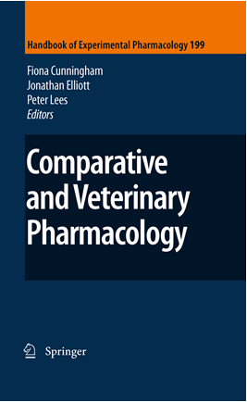
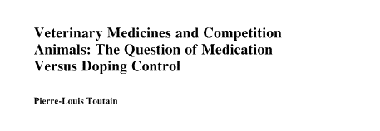
A review of the EU approach

Slide 3











European Horserace Scientific Liason Committee (EHSLC)

Slide 4

Type of substances: prohibition grading
Prohibited
Doping
Banned
Zero tolerance
Analytical methods
Medication
Controlled
Screening limits
PK/PD
Endogenous
contamination
Threshold levels
Statistical risk
Substances
Not Prohibited
No control
Vitamins Antiparasitics
Antibiotics
Notes:
Any substance prohibited by Regulations will be referred to as a Prohibited Substance which is now meant to be the umbrella term;
However, substances classified as Doping under the FEI Rules will be referred to as Banned Substances while substances classified as Controlled Medication under the FEI Rules will be referred to as Controlled Medication Substances.
a clear distinction between:
Medication, i.e. veterinary treatment justifiably provided to safeguard the animal’s health and welfare
Doping, i.e. the deliberate intent to affect the performance of a horse or to mask an underlying health problem

Slide 5
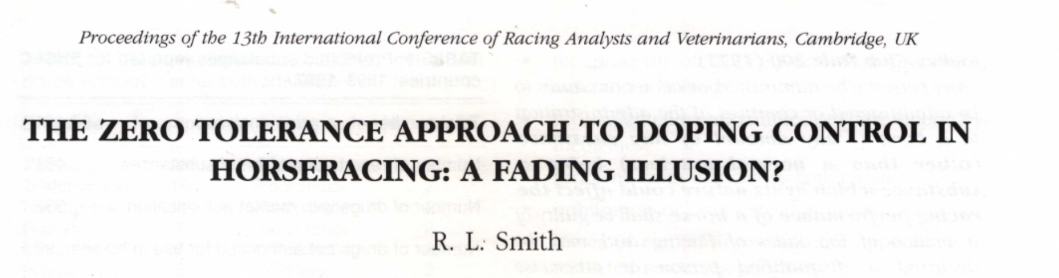
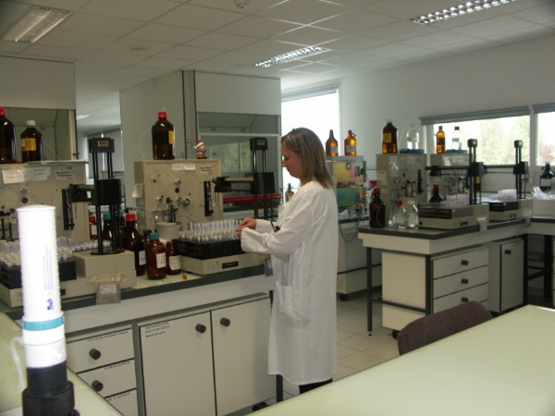
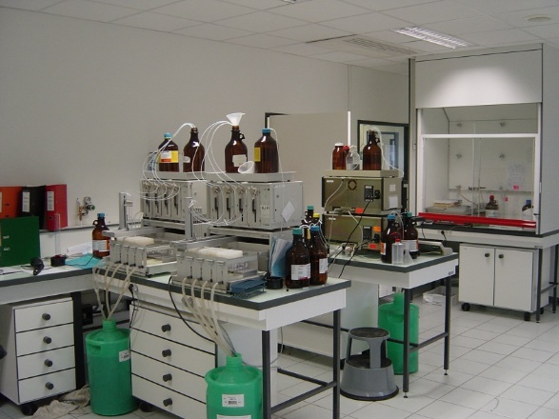
The end of the zero tolerance for medication control: the issue
Notes:
Increasing sensitivity of analytical techniques is :
Desirable for potent illegitimate drugs
Unsuitable for therapeutic substances because trace concentrations of therapeutic substances totally irrelevant in terms of effects, may be detected a long time after their administration

Slide 6

Testing exposure and the end of a zero tolerance approach for medication control (e.g. PBZ)
(ng/ml)
Detection time
10
5 h
1.0
2 days
0.1
20 days
Time (days)
Need for limitation on the sensitivity of testing for therapeutic agents

Slide 7
Issue for DT of a repeated drug administration:
The case of a very late terminal half-life
Delay 289
SL=0.03
Delay 54H

Slide 8
Doping control policy at time of racing
The EHSLC' question
  How to avoid to detect trace level of drugs (medications) without any pharmacological meaning
The question in operational terms
  What should be the order of magnitude of screening limit of analytical technique for the control of drug effect (not drug exposure )

Slide 9
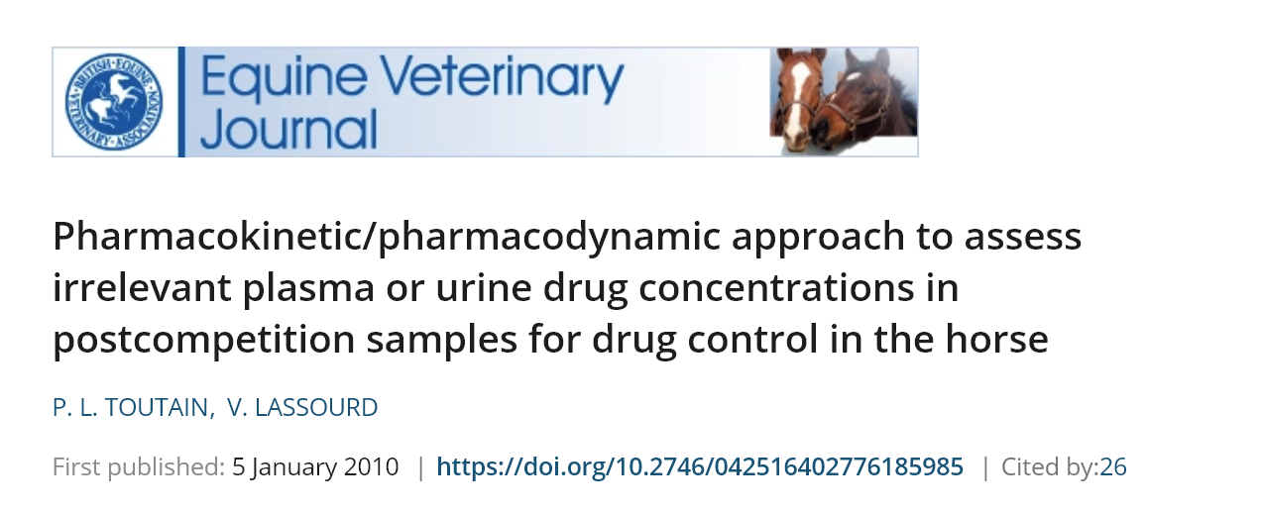
The “zero tolerance rule” is not suitable for medication control
This opens the way to a new approach for legitimate medication based upon PK/PD principles to estimate the order of magnitude of the so-called irrelevant drug concentrations in plasma and urine and to limit the sensitivity of analytical techniques used for medication control.
Notes:
For medication control, a non-experimental PK/PD approach to determine irrelevant drug plasma concentrations (IPC) and irrelevant urine concentrations (IUC).

Slide 10
The decision making process on no significant effect levels by EHSLC.
A risk analysis integrated approach
Notes:
Before to explain the PK/PD approach for the setting of screening limit, Ihave to explain that the EHSLC works following the principle odf risk analysis
The reasons to follow a risk analysis are when harmonization is in order, regulatory decisions need to take into account competitive interests in an unbiased and transparent approach.

Slide 11
The 3 main steps of a Risk analysis at EHSLC
1
Risk assessment
2
Risk management
3
Risk communication
1
Science (PK/PD)
2
Decision
3
Communication
1
EPC,IPC,IUC
2
Screening limits
Harmonization
3
Detection times
Notes:
What is a risk analysis: A systematic way of collecting, evaluating and recording information leading to recommendations for a position or action in response to an identified hazard (here medications or illicit substances)
The reasons to follow a risk analysis are when harmonization is in order, regulatory decisions need to take into account competitive interests in an unbiased and transparent approach.

Slide 12
How to determine effective plasma concentrations & effective urine concentrations?

Slide 13
Effective dose
Dose
Response
clinical
Black box
PK/PD
PK
PD
Dose
Body
pathogen
Response
Plasma
concentration

Slide 14

A fundamental relationship
$$Dose=\frac{Body Clearance×Therapeutic concentrations}{Bioavailability}$$
!
A dose can be determined rationally using a PK/PD approach
Notes:
For medication control, the dose is known and the main goal of PK/PD tools is to estimate efficacious plasma concentrations

Slide 15


Effective plasma Concentration
$$Dose=\frac{Body Clearance×Therapeutic concentrations}{Bioavailability}$$
$$Therapeutic conentrations=\frac{Dose×Bioavailability}{Body clearance}$$
With Bioavailablity=1 for the IV route

Slide 16
An example:
Phenylbutazone

Slide 17
The PK/PD approach to determine irrelevant plasma or urine drug concentrations
Steps :
  1: effective plasma concentration (EPC)
  2: Irrelevant plasma concentration (IPC)
  3: Irrelevant urine concentration (IUC)

Slide 18
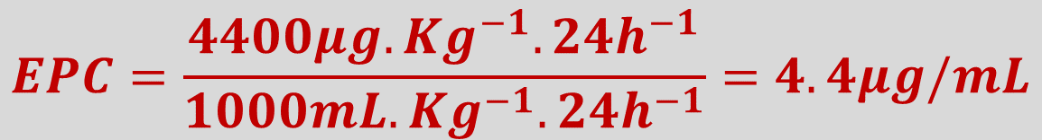
Step 1 : example of phenylbutazone
Standard dose: 4.4 mg/kg/24 h
Plasma clearance: 41 mL/kg/h or about 1000 mL/kg/24 h
$$EPC=\frac{4400μg.{Kg}^{−1}.{24h}^{−1}}{1000mL.{Kg}^{−1}.24h^{−1}}=4.4μg/mL$$
From PK/PD experiment 1.5 to 4.3 µg/mL

Slide 19


Step 2: computation of irrelevant plasma concentrations
An IPC can be deduced from EPC by applying a safety factor (SF) to EPC:
$$IPC=\frac{EPC}{SF}$$
How to select SF?

Slide 20
Step 2: how to select safety factor
SF
Values
Should reflect the degree of confidence we want the IPC is actually an IPC (Values)
EHSLC: no effect (2%)
Science
Shape of the dose-effect relationship
Large interindividual variability
Effect having different potency

Slide 21
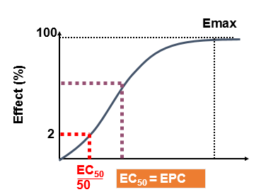
Safety factor: Why a default value=500
500=50X10
10 for Interindividual horse variability
50 to Transform an EPC into an IPC for a given horse
PK variability 3.3
PD variability 3.3

Slide 22
EPC, IPC and the sensitivity of the dose-response curve
30
n3
20
12%
n2
100
10
2%
n1
n1= 2
0
0
0.2
0.4
n2 = 1
80
Dose
n3 = 0.5
60
Effects
Slope = sensitivity
40
20
0
Dose
0.01
0.1
1
10
100
1000
ED
50

Slide 23
PBZ: computation of an irrelevant plasma concentration (IPC)
50 X 10
To transform an effective plasma (EC_{50%}) concentration to an ineffective plasma concentration (EC_{2%})
To take into account PK and PD variability
CV=36% for clearance=3.3
CV=36% For PD=3.3

Slide 24
Step 2 : the case of Phenylbutazone
by rounding up : 10 ng/mL

Slide 25

Step 3: determination of irrelevant urine concentration (IUC)
$$IUC=IPC×R_{SS}$$
steady state urine to plasma concentration ratio
10
Rss = 10
concentration
urine
1
Plasma
(time)
Pseudo-equilibrium state

Slide 26
Step 3 irrelevant urine concentration (IUC): the case of PBZ
R_{SS} = 1
IUC = IPC x R_{SS}
IUC = 10 ng/mL x 1 = 10 ng/mL

Slide 27
Rss is not a robust parameter
For a given plasma concentration, urine concentrations may be influenced by many factors such as:
  urine flow,
  pH (for ionisable drugs)
  etc.
rendering the relationship between plasma and urine concentration rather loose

Slide 28
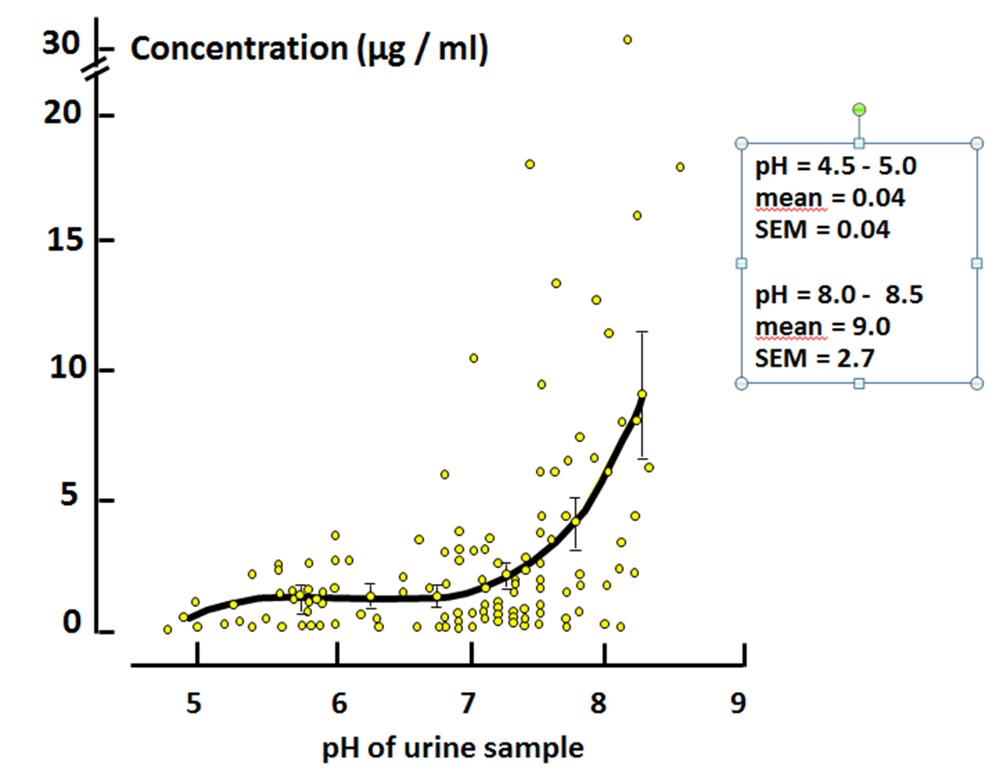
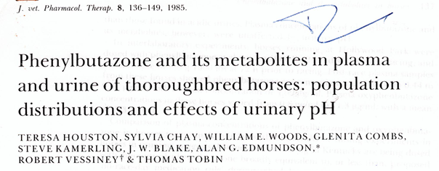
PBZ urinary concentration vs. urine pH

Slide 29
Urinary pH in horse
1200
UK
Japan
1000
800
600
600
400
400
200
200
0
0
5.0
6.0
7.0
8.0
9.0
5.0
6.0
7.0
8.0
9.0
10.0
pH
Tobin, 1981

Slide 30
Relationship between urine and plasma concentration
The urine concentration will depend on two factors
  amount of drug eliminated in urine (± a drug property)
  urine volume (a horse property)
relationship between plasma and urine concentration can become obscure
  e.g.: urine pH for PBZ
Urine is less than an ideal matrix to control no effect level

Slide 31
Rapport IUC/IPC
Most often IUC > IPC

Slide 32
The 3 main steps of a Risk analysis
Risk assessment
Risk management
Risk communication
ESL, ASL, ISL
Science + other considerations
differences expected between organizations:
harmonization

Slide 33
From the IUC to the SL
IUCs are calculated by scientists after a risk assessment
ISLs are fixed by risk manager from the IUCs as starting values

Slide 34
Risk management
Determination of the SL
(International) Screening Limits:
An instruction (expressed as a concentration) to laboratories from racing authorities to control the detection of drugs commonly used in equine medication at a level that is considered NOT to be threat to welfare of the horse, alter its racing or compromise the integrity of racing

Slide 35
How to decide a Screening Limit
Selection of a scale

Slide 36
Four possible measurement scales
All measurements in science can be conducted using four different types of scales called:
  Nominal scale
  Ordinal scale:
  Interval scale
  Ratio scale

Slide 37
The two possible scales for ESL
Ordinal
  Ordinal measurements describe order, but not relative size or degree of difference between the items measured.
Ratio scale
  Most measurement in the physical sciences is done on ratio scales. Mass, concentrations , time…,
  Absolute value with units
    The result of a horse race are given is using an ordinal scale which says only which horses arrived first, second, or third … and not a ratio scale which will take into account race times.

Slide 38
Why an ordinal scale?
Selection of an ISL is a non quantitative decision and cannot be assimilated to a statistically founded threshold (as for cortisol, testosterone…)
Consistency of reporting between laboratories much more easy with an ordinal scale

Slide 39
From IUC to IPC: An hypothetical example
It is a Anti-inflammatory drug
IUC=38 ng/mL
Possible values of the ordinal scale for a ISL
  10, 50, 100, 250, 500 etc
The manager will likely choose either 10 or 50 ng/mL, the 2 values that bracket the IUC
The final choice will take into account the difficulty or not to harmonize, if the drug is of major concern or not, cost of machines etc.

Slide 40
Risk management for PBZ
EHSLC SL was 50ng/mL
Now, after international harmonization , the international SL is 100ng/mL

Slide 41
Two different approaches to determine a SL
Assessment
EPC,IPC,IUC
A mater of fact
Management
SL
Communication
DT/WT
Management
SL
Harmonization
Discussion
DT/WT
A pragmatic decision

Slide 42
The 3 main steps of a Risk analysis at EHSLC: Risk management
1
Risk assessment
2
Risk management
3
Risk communication
Science
Decision
3
Communication
2
1
1
2
Screening limits
3
Detection times
EPC,IPC,IUC
Harmonisation
How to help Treating Vets

Slide 43
How to help Treating Vets
For medication control ISL is not "ready for use" information for veterinarians who must advise owners or trainers on appropriate withholding times.
Detection time is the only practical information needed by veterinarians and horse industry that EHLSC can release

Slide 44
What is a detection time: just an observation
              DT is the time at which the urinary (or plasma) concentrations of a drug, in all horses involved in a particular trial conducted according to the EHSLC guidance rules, are observed to be lower than the ISL when controls are performed using routine screening methods.
ISL
time
DT

Slide 45

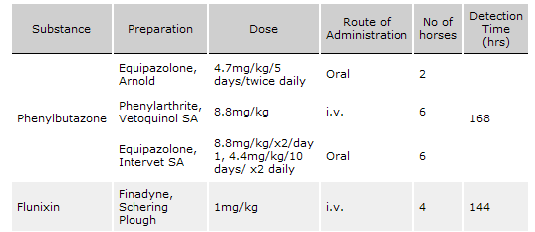

Slide 46

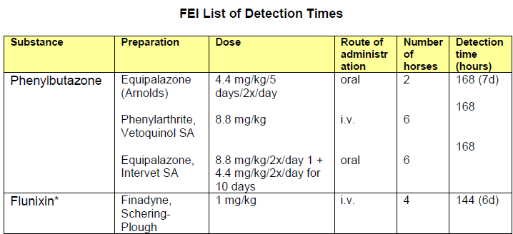

Slide 47
Detection Time
From IV: the minimal detection time most often for a single dose without statistical protection
Detection time is not a parameter but a variable associated to:
  Dose, route of administration, formulation, number of investigated horses etc.

Slide 48
EHLSC decided to release Detection times (DT) an not Withdrawal time (WT)
DT: An information given by Authorities without statistical protection
WT: A Vet recommendation based on his own risk analysis

Slide 49



Factors affecting a WT
Dosage regimen:
Dose
Dosage interval
Route of administration
Site of administration
etc
Drug
formulation
Source
vehicle
Horse:
Breed
Age
Sex
Health status
Food
Rest/activity
Training/out of training
Definition and the selected experimental design to determine the WT:
Number of horses
Sampling time
Urine pH
        It is not the responsibility of EHLSC to guarantee a WP

Slide 50
From the Detection Time to a Withdrawal period

Slide 51
From a detection time to a withdrawal time
To help the veterinarian select a WT from a published DT the question of a safety span was explored using Monte Carlo Simulations (MCSs) (Toutain 2010.)

Slide 52
The model to compute a DT
Monocompartmental model
Bioavailability
0 to 1
Volume of distribution
Dose per kg BW
Body weight (kg)
Urine to plasma ratio

Slide 53
Sources of variabilities for a WT
Two main sources of variability
  Biological variability: not manageable
    Horses are different for pharmacokinetic (PK) parameters controlling plasma and urine drug disposition
    These sources of variability are explained by factors such as breed, age, sex, health status etc.
  Different sources of uncertainty associated with veterinary and trainer practices: manageable
    The actual administered dose
    Formulation
    Trained/untrained conditions etc.

Slide 54
Solving the model: Deterministic approach
Gives a single possible value

Slide 55

An add-in design to help Excel spreadsheet modelers perform Monte Carlo simulations
Others features
  Search optimal solution (e.g. dose) by finding the best combination of decision variables for the best possible results

Slide 56
Solving the model: Stochastic approach
ISL
Gives range of probable values

Slide 57
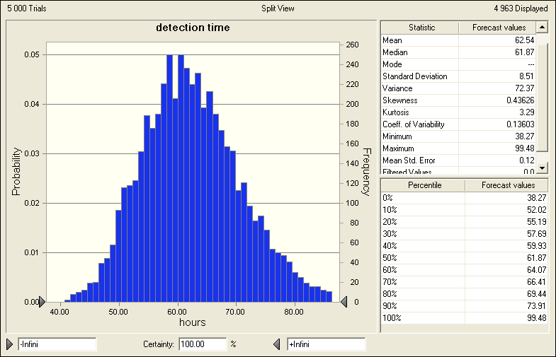
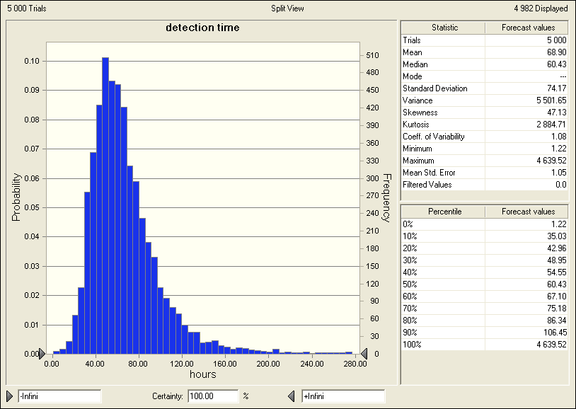
Influence of variability on DT
Same mean parameters but different coefficients of variation
CV=30%
DT: Quantile 90%=106h
CV=10%
DT: Quantile 90%=74h

Slide 58
Main results obtained by MCSs
For a low variability of PK parameters (CV=20%)
  P90/P50 was of 1.43 meaning that an uncertainty span of about 40% may be selected to transform a mean DT to a WT which will cover 90% of the horse population.
For a high variability of PK parameters (CV=40%)
  P90/P50 was of 2.1-2.2 meaning that uncertainty span of about 100% may be selected to transform a mean DT to a WT which will cover 90% of the horse population mean DT.

Slide 59
Sensitivity analysis
It may be of interest to identify the relative impact of the different factors of variability on the final WT because some of these factors can be controlled by veterinarians.
  the actual administered dose
  impact of using a different formulation to that used for the EHLSC trial.
  etc

Slide 60
Monte Carlo simulations: conclusions
The main sources of uncertainty are of biological origin
MCS suggest that a veterinarian can do nothing to control a DT through managerial procedures because the main sources of variability are of biological nature

Slide 61
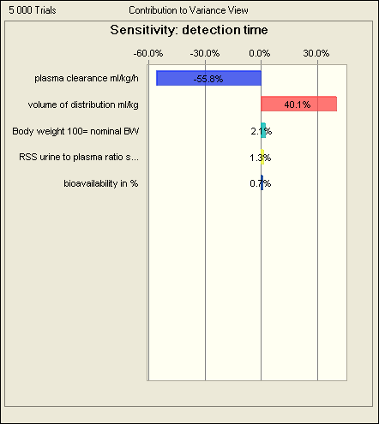
Sensitivity analysis

Slide 62
Influence of the administered dose vs. the terminal half-life on a detection time (h)
Doubling the dose (+100%)
DT increase from 46h to 53h
Decreasing clearance by 30%
DT increase from 46h to 65h

Slide 63
The future to determine DT/ WT: Population approach

Slide 64
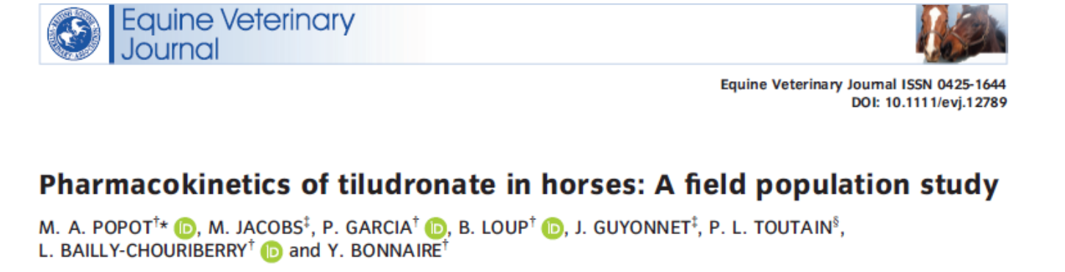
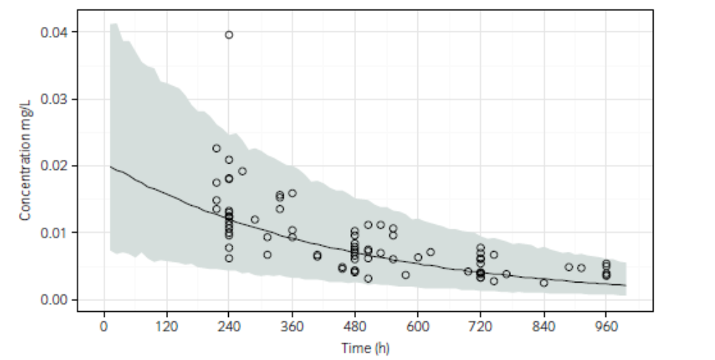
Tiludronic acid detection time
PK differences between healthy experimental horses and the population of horses being treated in the field
effect of level of training on plasma tiludronate.
Tiludronate concentrations observed in 39 horses after a single i.v. administration of Tildren (circle), median (black line) and 99% prediction interval obtained by population PK analysis (grey area).

Slide 65
Conclusion
The risk analysis approach was decisive to facilitate disscussion and decisions in EU
The PK/PD allowed to use a scientific based appraoch to determine IPC/IUC
The future is population PK
  To perform meta-analysis of already collected data
  To investigate the DT/WT in field conditions

